Slide 1


AI/Run™ .Transform
Changing the present and shaping the future of AI-Native Engineering
OCTOBER 2025

Slide 3
Agenda
01
State of AI in Software Development: Key Themes for 2025
02
AI Adoption Strategy
03
EPAM’s Expertise & Experience in End-to-End SDLC Capabilities
05
Lessons Learned from Large-Scale Client Adoptions

Slide 4

State of AI in Software Development: Key Themes for 2025
01
Industry AI spend
Models rapid progression
Maturing technology and techniques
Main themes and trends
EPAM Proprietary & Confidential.
4
Notes:
Last Update date: ? Slide Owners: Thought Leaders: Aliaksandr Paklonski /Tatsiana Hmyrak
Senior Practitioners: Alexey Zalesov / Alena Zakharyeva Model Intelligence Convergence: Top models reach parity as open source catches up to GPT-4, Claude, and Gemini 2.0
Dramatic Cost Reduction: ~100x decrease in inference costs since GPT-3.5's making enterprise-scale implementation feasible
Reasoning Models/Test-Time Scaling: brand new models architecture with GPT-O1, O3 and Gemini 2.0's Flash Thinking
Prompt Engineering as Established Field: from ad-hoc techniques to structured methodologies, with established patterns like Chain-of-Thought and Tree-of-Thoughts becoming standard practice
From LLMs to Multimodal Capabilities: Models now seamlessly handle text, images, audio, and video inputs in real time
Production-Ready RAG Solutions: RAG matured from experimental to enterprise-grade, with robust patterns for knowledge integration and dynamic information access
Numerous Established AI Development Frameworks: End-to-end solutions now cover the full AI application lifecycle, including RAG implementation, agent orchestration, workflow management, and production monitoring
Challenged Status Quo in IDEs Space: from GitHub Copilot dominance, to “AI Native IDE” experience with the new solutions such as V0, Bolt, Cursor, Windsurf, to OS wide AI experience with Claude Computer Use

Slide 5
Future of AI in Software Development
Agentic Project Teams
Forming fully autonomous AI project teams capable of taking ownership of low to medium complexity backlog items — from refining requirements and breaking down stories to development, testing, and deployment.
Task Length:
1 week
AI ENGINEERING Future Outlook
“META-AGILE” –
Post Agile Humans-to-Agents and Agents-to-Agents software development lifecycle paradigm shift
Projected Evolution
“META-AGILE”
Autonomous AI Workflows
AI-driven batch workflows to tackle complex tasks like migrating applications from one framework to another, bulk security issues resolution, and automated test coverage
Task Length:
4 hours – 2 days
Chat-Oriented Programming
Increasingly chat driven interactions to write code
Agents are embedded into current interface
Humans are heavily in the loop
Vibe-coding as rapid prototyping technique
Task Length: 2 min – 1 hour
AI Code-Completion
AI as an assistants for recommending next set of lines of code
Task Length: 30 sec – 1 min
Experimentation is here
Technology is here
Market adoption
is here
Personalized & Self Learning Agents
Specialized LLMs/SLMs
Continued LLMs Advancements
Notes:
Last Update date: Sept 22 Slide Owners: Thought Leaders: Tatsiana Hmyrak / Aliaksandr Paklonski
Senior Practitioners: Tatsiana Hmyrak / Aliaksandr Paklonski

Slide 6





Gigantic Investments into AI Infrastructure
EXECUTIVE ORDER ON ADVANCING UNITED STATES LEADERSHIP IN ARTIFICIAL INTELLIGENCE INFRASTRUCTURE
Building AI in the United States requires enormous private-sector investments in infrastructure, especially for the advanced computing clusters needed to train AI models
$29+ billion
~$80 billion
Google reported spend on AI in 2024 is 29B.
The company is continuing to spend big on AI.
Alphabet's capital expenditures in 2025 would be higher than this year.
2024 AI spend was $46B.
In FY 2025, Microsoft is on track to invest approximately $80 billion to build out AI-enabled datacenters to train AI models and deploy AI and cloud-based applications around the world
Source
Source
$19+ billion
$27+ billion
2024 AI spend was $19B.
AWS plans to invest at least $11 billion in Georgia alone to expand infrastructure to support AI and cloud technologies
2024 AI spend was $27B.
Meta expect spending will grow in 2025, including a "significant acceleration in infrastructure expense growth" to support Meta's AI products.
Source
Source
Notes:
White House: https://www.whitehouse.gov/briefing-room/presidential-actions/2025/01/14/executive-order-on-advancing-united-states-leadership-in-artificial-intelligence-infrastructure/
Microsoft: https://blogs.microsoft.com/on-the-issues/2025/01/03/the-golden-opportunity-for-american-ai/#:~:text=In%20FY%202025%2C%20Microsoft%20is,based%20applications%20around%20the%20world.
Google:
Meta: https://www.investopedia.com/meta-says-it-is-making-progress-with-ai-as-spending-grows-8737166
Amazon:
Can you find numbers mentioned by Google, Amazon, Meta for 2025?
Investment in AI infra
Models, cloud hosting, copilots, agents.
Anomaly gigantic investment from all companies
2025 – MS are ready to spend 80B

Slide 7



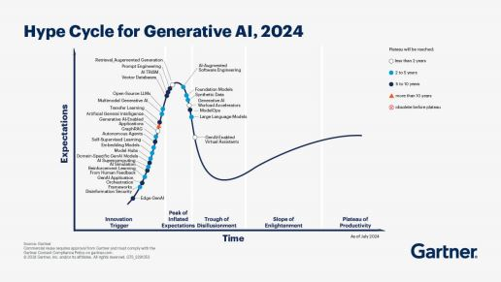



The “Year of Agents”
AI agents are on track to reach the top of the Gartner Hype Cycle in 2025.
IDC’S 2024 AI OPPORTUNITY STUDY
Sponsored by Microsoft
Companies are gravitating to more advanced AI solutions.
In the next 24 months, more companies expect to build custom AI solutions tailored directly to industry needs and business processes, including custom copilots and AI agents.
CES 2025 Keynote
Microsoft CEO Note
Google Cloud Blog
Amazon Q Developer: Transform
Nvidia CEO Jensen Huang stressed upon the significance of agentic AI, that could eventually revolutionize the workforce and provide a major boom for those companies who are deeply invested into agentic AI research and development.
Industry is approaching the next stage of AI development, with enterprises globally focusing heavily on agentic AI adoption.
Microsoft’s focus in the year ahead will be on building out its agentic AI capabilities
We’ve gone from experimentation to seeing hundreds of gen AI agents come to life in the real world.
Amazon launches the first generative AI–powered assistant for transforming .NET, mainframe, VMware, and Java workloads accelerating large-scale transformation of enterprise workloads with domain-expert generative AI agents
Notes:
1) Google: AI's impact on industries in 2025 | Google Cloud Blog , https://cloud.google.com/transform/101-real-world-generative-ai-use-cases-from-industry-leaders
2) NVIDIA CEO Jensen Huang Keynote at CES 2025:
https://blogs.nvidia.com/blog/ces-2025-jensen-huang/
https://m.economictimes.com/news/international/us/what-are-ai-agents-that-nvidia-ceo-jensen-huang-says-are-a-multitrillion-dollar-opportunity/amp_articleshow/117247927.cms
3) Microsoft, Satya Nadella: https://blogs.microsoft.com/blog/2025/01/13/introducing-core-ai-platform-and-tools/
IDC Research sponsored b y Microsoft : https://blogs.microsoft.com/blog/2024/11/12/idcs-2024-ai-opportunity-study-top-five-ai-trends-to-watch/
To help guide organizations on their AI transformation journey, Microsoft recently commissioned a new study through IDC, The Business Opportunity of AI. IDC’s findings show that when organizations truly commit to and invest in AI, the return on investment (ROI) potential grows significantly.

Slide 8

AI Production Adoption, Strategy Consolidation, and Measurable Outcomes Focus Area
Implementation challenges will stall more than 50% of agentic and AI agent efforts.
Source
How AI Agents Will Disrupt Software Engineering, Sept 24, 2024
IDC Chief Research Officer:
Integrating AI agents throughout a developer’s entire workflow will be immensely challenging.
Recommendations:
Enhance developer experience by IMPLEMENTING A PILOT that focuses on one phase of the SDLC where developers will work with an AI agent.
Integrate AI agents STRATEGICALLY to enhance elements of developer experience. PRIORITIZE ADOPTION OF TOOLS that address your developer’s top friction points.
MEASURE THE IMPACT OF AI AGENTS on developer productivity and satisfaction by defining relevant key performance indicators (KPIs).
Conduct regular reviews to measure the business impact of AI agents, and adjust your approach for using AI agents based on developer feedback and performance data.
“
In 2024 organizations have conducted an average of 37 proofs of concept, but only about 5 have moved into production. It’s been a year of intense experimentation.
What will it take to move from experimentation to adoption? The key areas are:
Enterprise AI strategy
Unified governance model
Managing the technology costs associated with GenAI“
Notes:
AI experiments – failed at Client
Need to explain:
No failure is achieved through adoption, with the right strategy, with the measurement framework.
Need to have the above three points to make experiments successful.
Analyst to prove – “companies need to create umbrella competency for AI adoption.
Forrester article: https://www.forrester.com/blogs/2025-is-the-year-of-ai-maturation-and-solidification-in-india/
IDC chief research officer interview: GenAI, from experimentation to adoption - https://www.cio.com/article/3627447/idc-chief-research-officer-genai-from-experimentation-to-adoption.html
Enterprises still need to get their basic act together, including:
having a proper data strategy and governance in place
working with the overall business in understating the business cases that can be solved using agentic AI
working with partners and software vendors on building templates and toolkits for easy adoption of agentic AI solutions.

Slide 9
AI Technologies and Trends – September 2025
AI ENGINEERING Future Outlook
Towards Deterministic LLMs
Ambient Assistance: From Autocomplete to Proactive Edits
AI Code Assistants Expand Beyond Developer Role & Enter the Enterprise
New research from Thinking Machines lab claims to achieve deterministic LLM outputs.
Deterministic LLMs would behave more like traditional computer programs and their outputs would be reproducible..
Ambient assistance is evolving from simple autocomplete to a more powerful interaction mode, where AI suggests edits without being explicitly prompted.
GitHub Copilot has released Next Edit Suggestions in public preview for JetBrains IDEs.
Cursor's Tab completion now suggests 21% fewer edits, with a 28% higher acceptance rate.
Support of AI Agents in popular in Enterprise IDEs, not only VSCode like ones (e.g. Windsurf plugin for IntelliJ)
Launch and advancements of Background and Multi-device Agents (Cursor) that allow to expand AI impact beyond coding use case.
Transition from dev centric IDE to a more agent-like platform with features for workflow automation and multi-step collaboration (Windsurf)
Prompt Engineering ->
Context Engineering
Companies share AI adoption stories
Codebases are becoming AI-first
Context Engineering = dynamically assembling just‑enough task framing + relevant retrieved evidence + episodic memory + tool specs each turn—an orchestrated upgrade from static prompt craft
It optimizes retrieval, re‑ranking, compression and long‑vs‑retrieval trade‑offs to stay precise and cost‑efficient within context windows
At Booking.com, 65% of developers use AI tools; the industry median is 50%.
At WorkHuman, AI contributed to an 11% improvement in developer experience across the organization.
Developers at WorkHuman who regularly used AI showed a 15% increase in velocity compared to non-users.
The cost of AI-enabled developer tooling can reach several hundred dollars per developer per month.
Teams are now actively modifying their codebases to make them more understandable for AI agents.
They focus on maintaining clean service boundaries and define explicit interfaces within these boundaries to clarify interactions.
Teams now create documentation for both human developers and AI agents, with AI-focused docs emphasizing code samples and omitting visuals.
Notes:
Last Update date: September 17 Slide Owners: Thought Leaders: Tatsiana Hmyrak / Aliaksandr Paklonski
Senior Practitioners: Alexey Zalesov
Sources:
1&2 Open-Weight Models available across major Clouds and Local Deployments and Pioneering Wave of Thousand-Tokens-Per-Second Models for End-to-End Tasks
https://openai.com/index/introducing-gpt-5/
https://openai.com/index/introducing-gpt-oss/
https://www.cerebras.ai/news/cerebras-helps-power-openai-s-open-model-at-world-record-inference-speeds-gpt-oss-120b-delivers
https://www.aboutamazon.com/news/aws/openai-models-amazon-bedrock-sagemaker
https://cloud.google.com/blog/products/containers-kubernetes/run-openais-new-gpt-oss-model-at-scale-with-gke
https://moonshotai.github.io/Kimi-K2/
https://z.ai/blog/glm-4.5
https://www.cerebras.ai/blog/qwen3-coder-480b-is-live-on-cerebras
https://simonwillison.net/2025/Aug/5/gpt-oss/
3. AI Code Assistants Expand Beyond Developer Role & Enter the Enterprise
https://windsurf.com/plugins - IntelliJ plugin
https://cursor.com/en/changelog, https://www.analyticsvidhya.com/blog/2025/07/cursor-agent-guide/ – Background Agents in Cursor
https://www.lifewire.com/enterprise-beware-cognition-acquires-windsurf-11772127 Windsurf
https://www.cnbc.com/2025/07/11/goldman-sachs-autonomous-coder-pilot-marks-major-ai-milestone.html – GS pilots their first autonomous coder
https://www.americanbanker.com/news/citi-is-rolling-out-agentic-ai-to-its-40-000-developers - City is rolling out agentic AI to its 40K developers
4. CSP Advance Modernization & SDLC Agents
https://techcommunity.microsoft.com/blog/azuremigrationblog/introducing-azure-migrate-explore-with-ai-assistant/4421931
https://www.microsoft.com/en-us/microsoft-copilot/blog/copilot-studio/introducing-agent-flows-transforming-automation-with-ai-first-workflows/
5. Prompt Engineering -> Context engineering
https://contextual.ai/ - seems unrelated https://www.perplexity.ai/search/is-contextual-io-related-direc-bKng6eWmRxGS62WnQxTXfw
https://blog.langchain.com/the-rise-of-context-engineering/
the concept introduced by one tweet (https://x.com/tobi/status/1935533422589399127) and amplified by another (https://x.com/karpathy/status/1937902205765607626)
6. Agentic Personalization Through Multi-Level Self-Learning
https://dev.to/idavidov13/one-file-to-rule-them-all-cursor-windsurf-and-vs-code-hh2
https://rizumita.medium.com/mimicking-windsurfs-memory-feature-in-cursor-let-generative-ai-create-rules-c5d2c1976c4d
Addition: https://newsletter.pragmaticengineer.com/p/measuring-the-impact-of-ai-on-software
7. Towards Deterministic LLMs
Source: https://thinkingmachines.ai/blog/defeating-nondeterminism-in-llm-inference/
8. Ambient Assistance: From Autocomplete to Proactive Edits:
Sources:
- https://github.blog/changelog/2025-08-29-copilots-next-edit-suggestion-nes-in-public-preview-in-jetbrains/
- https://cursor.com/blog/tab-rl
Another version from Sasha P
As of 28 Aug 2025 :
1. Agentic AI Goes Mainstream in Development Workflows
Agentic AI frameworks like Microsoft AutoGen, CrewAI, LangGraph, and AgentGPT existed before 2025 but significantly matured and gained mainstream production adoption in the summer of 2025. These platforms evolved from early research tools into reliable systems orchestrating autonomous agents for planning, coding, and testing workflows. This shift marks a tipping point where agentic AI has become integral to enterprise software development.
2. Code Generation CLI Tools and AI-Native IDEs Dominate
AI coding assistants embedded inside development environments now offer robust repository-level automation and multi-file context management. Leading tools such as Claude Code CLI and Cursor enable autonomous background coding agents, freeing developers to focus on higher-value tasks. This trend transforms traditional IDEs into AI-first software development platforms.
3. Multimodal AI Integration in Development Tools
Cutting-edge multimodal AI models handle text, images, audio, and video inputs simultaneously, allowing new workflows like coding from screenshots or enriched multimedia documentation. Platforms like LangChain and Microsoft AutoGen lead agent orchestration combining multiple modalities, expanding developers’ capabilities beyond text-based programming.
4. Edge AI Infrastructure and Development Frameworks
Edge AI boomed in mid-2025, supported by frameworks such as TensorFlow Lite, PyTorch Mobile, and Edge Impulse, and hardware advances like Google Edge TPU. These allow complex models to run locally on devices, enhancing privacy, reducing latency, and enabling autonomous real-time applications without cloud reliance.
5. GPT-5's Unified Architecture and Intelligent Routing
GPT-5, available since August 2025, introduces a unified system dynamically routing tasks across specialized models for optimal balancing of speed and deep reasoning. It supports extended contexts up to 400,000 tokens and offers seamless transitions between lightweight and powerful reasoning models. This architectural leap simplifies AI application development and deployment.
6. AI-Native Infrastructure Automation Platforms
Platforms like System Initiative use AI agents coupled with high-fidelity digital twins to autonomously manage and modify infrastructure based on natural language commands. This replaces traditional manual infrastructure coding, automating complex tasks that previously took weeks into reliable minutes-long operations.

Slide 10
MCP Is Trending, Enabling the Shift Toward More Integrated, Context-Aware AI
Model Context Protocol is a standardized open protocol that simplifies how AI models and agents interact with external data and tools
WHY is it popular?
Solves integration problems
Strong community and rapid, widespread adoption
Open, model-agnostic, and backed by a major AI player
Actively improved with ongoing developer education
MCP CLIENT HOST
MCP SERVER
Claude Desktop
GitHub Copilot
Cursor
SourceGraph Cody
Windsurf
EPAM AI/Run
…
Brave Search
Google Drive
AWS
Slack
Puppeteer
GitHub
Grafana
PayPal
Perplexity
EPAM AI/Run
..
MCP
Awesome MCP Servers: https://mcpservers.org/
Notes:
Last Update date: April 9, 2025 Slide Owners: Thought Leaders: Tatsiana Hmyrak / Aliaksandr Paklonski
Senior Practitioners: Tatsiana Hmyrak / Aliaksandr Paklonski

Slide 11

Decoding the Trio: Chats, Copilots and Agents in SDLC Workflows
Chats
Facilitate communication, troubleshooting, and learning throughout the SDLC
Copilots
Focus on helping individual developers with coding and technical tasks
Agents
Manage automated workflows across infrastructure and teams, deploy and manage the code
Aspect | Chats | Copilots | Agents
Scope | Provide conversational assistance | Assist individual developers | Automate workflows & systems
Primary Use Case | Problem-solving & collaboration | Code writing & debugging | Workflow orchestration
Interaction | Natural language-based queries | Embedded in coding tools | Autonomous, event-driven
Focus | Knowledge sharing & communication | Developer productivity | Process efficiency
Stage in SDLC | Cross-stage use (requirements, testing, etc.) | Development phase | All stages of SDLC
Examples | ChatGPT, Bing Chat, Google Bard, EPAM DIAL AI | GitHub Copilot, CodeWhisperer, Amazon Q, Cursor, EPAM ELITEA, Windsurf (ex.Codeium) | EPAM ELITEA, EPAM CodeMie, Amazon Bedrock, Microsoft Copilot Studio, Vertex AI Studio
Notes:
Dima
How Copilots, Agents, and Chat Systems Complement Each Other
Copilots (e.g., GitHub Copilot): Focused on helping individual developers with coding and technical tasks.
Agents (e.g., Jenkins/Kubernetes): Manage automated workflows across infrastructure and teams.
Chat Systems (e.g., ChatGPT): Serve as SDLC encyclopedias, conversational troubleshooters, and collaborative tools.
Together, they can form a collaborative ecosystem in SDLC workflows:
Copilots write the code.
Agents deploy and manage the code.
Chat systems facilitate communication, troubleshooting, and learning throughout the SDLC.
By integrating these tools appropriately, teams can maximize productivity, automation, and collaboration across the entire software development lifecycle.

Slide 12
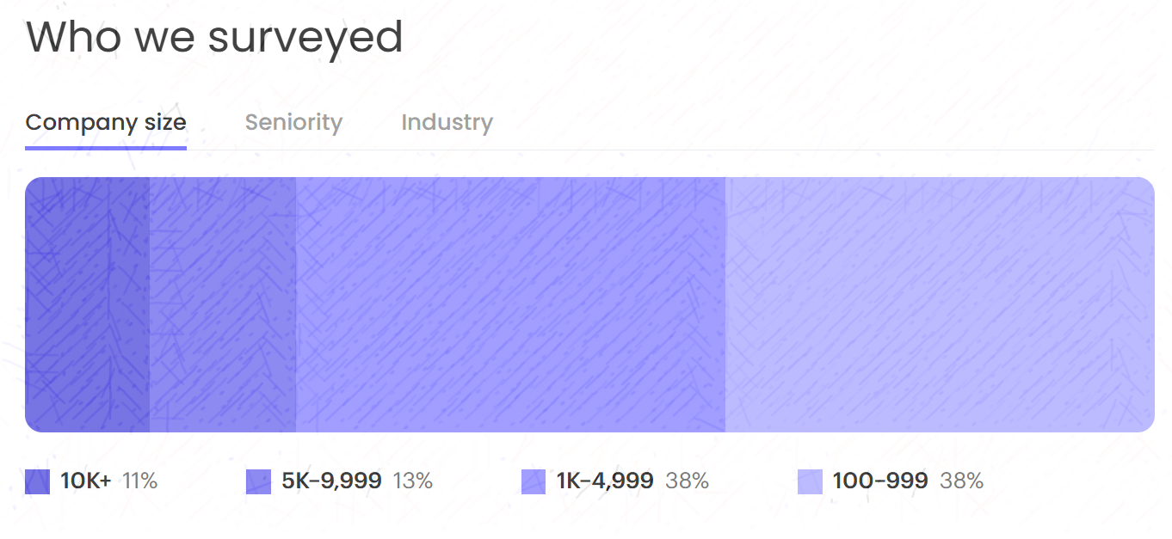





AI ‘Sabotaging’: Numbers Revealed
66%
of executives reported increased tension in the organization caused by AI-related initiatives.
The Writer 2025 generative AI survey gathers insights and experiences from 1,600 knowledge workers, including 800 C-suite executives and 800 employees.
55%
of employees were described as “in denial,” “resistant,” “reluctant,” or “indifferent” about
AI integration.
42%
of executives stated that generative AI is “tearing their company apart.”
41%
of Gen Z employees admitted to resisting or not using AI tools.
31%
of all employees said they are actively resisting or sabotaging their company’s AI efforts.
Source: The Writer 2025 AI Survey
Notes:
Last Update date: April 9, 2025 (borrowed from Michelle) Slide Owners: Thought Leaders: Tatsiana Hmyrak / Aliaksandr Paklonski
Senior Practitioners: Tatsiana Hmyrak / Aliaksandr Paklonski

Slide 13
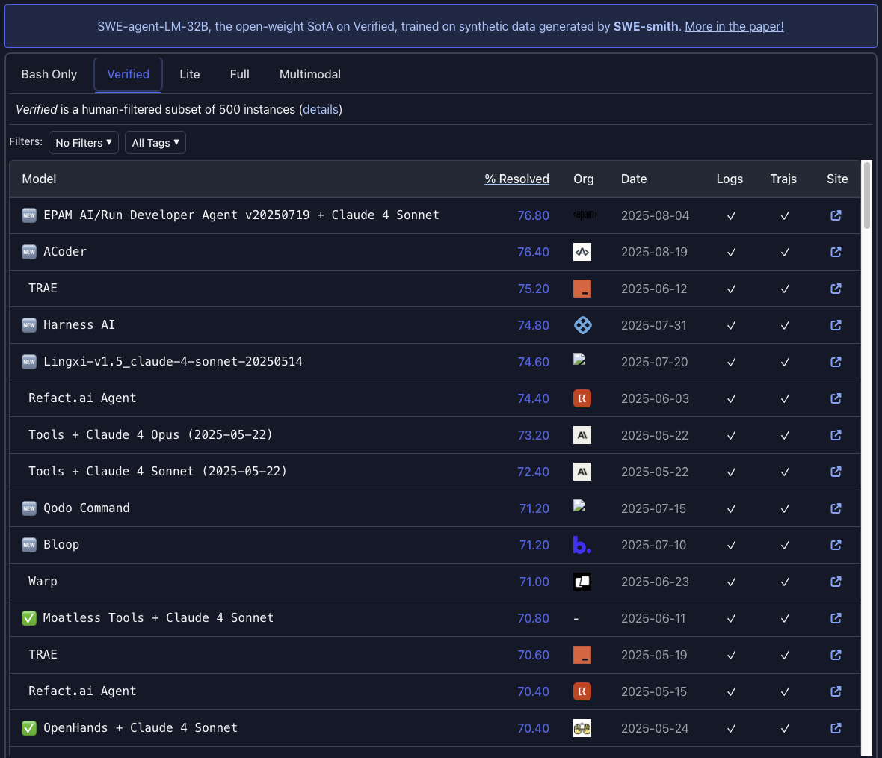
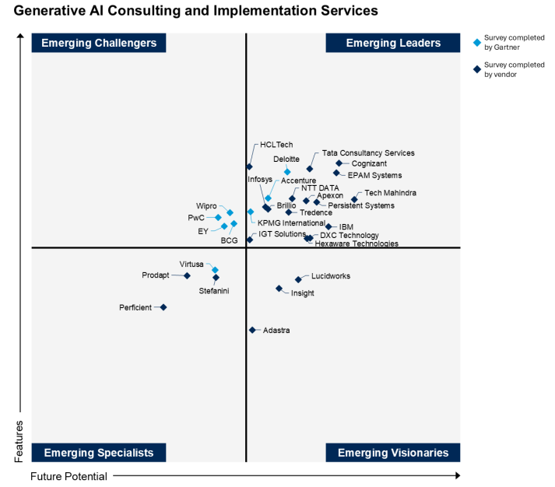
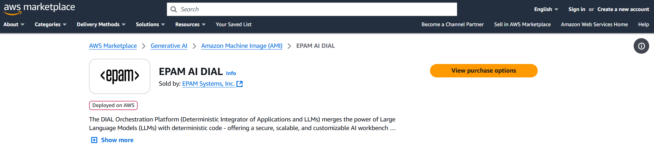
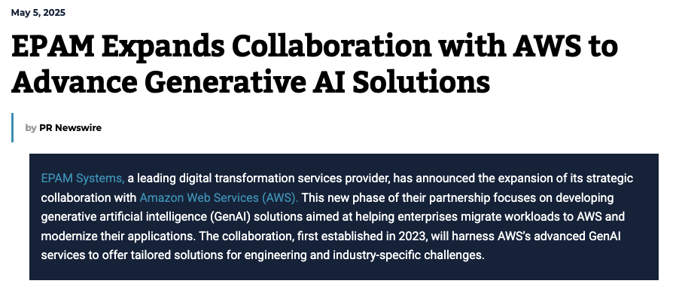
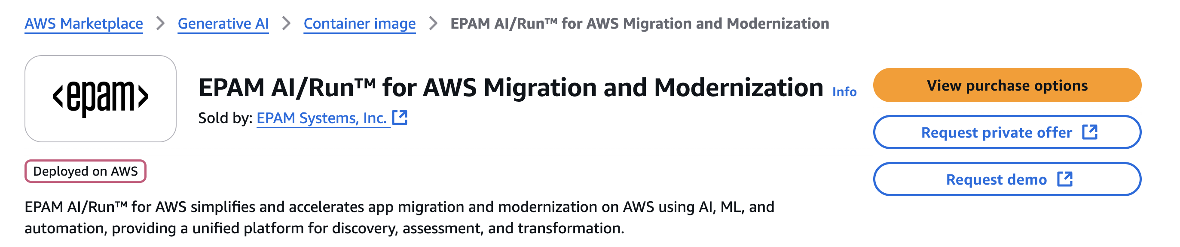
EPAM is Leading GenAI-Enabled Engineering
EPAM AI/Run Developer Agent is leading SWE-bench - industry-standard AI Coding Assessment Evaluation Toolset for software engineering.
EPAM is an Emerging Leader in Gartner's Emerging Market Quadrant for Generative AI Consulting and Implementation Services.
EPAM Enterprise GenAI Orchestration Platform DIAL is now on AWS Marketplace
Innovation Guide for Generative AI Consulting and Implementation Services
Published: August 14, 2025
Notes:
https://techedgeai.com/news/epam-expands-collaboration-with-aws-to-advance-generative-ai-solutions/

Slide 14
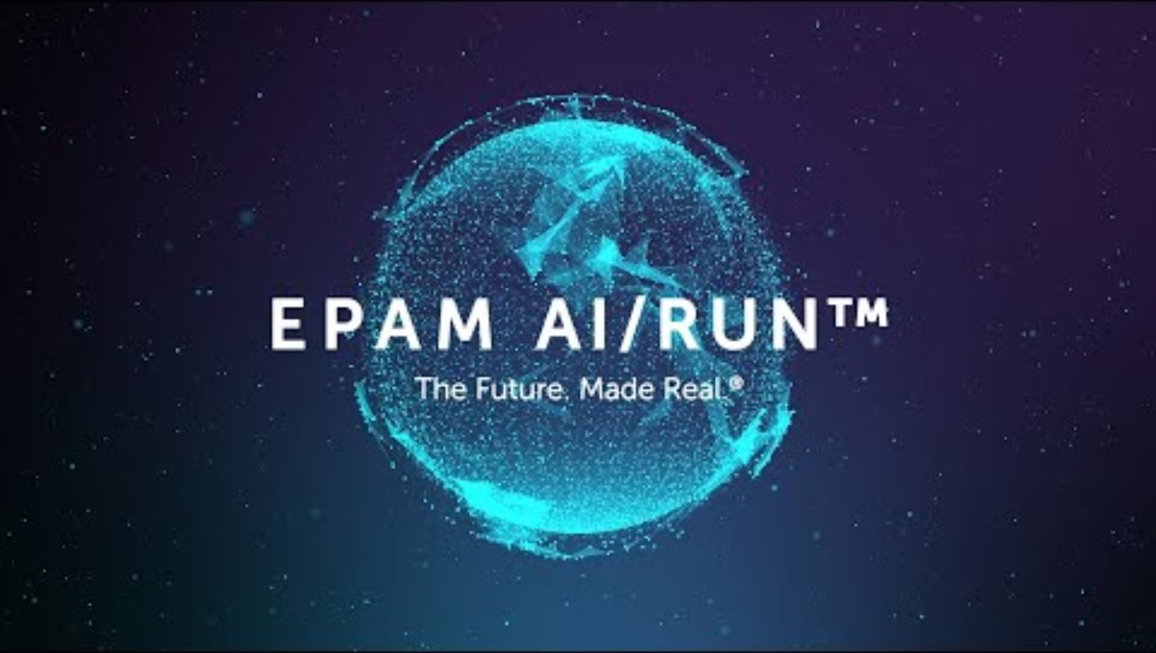
EPAM Al/Run
A practical approach to modern software engineering that leverages AI agents across the full SDLC to automate processes, accelerate quality feedback loops, and enable faster time-to-market while reducing costs.
Notes:
Dima
We have AI Run solution to enable AI in any IT organization
We’re not just offering a platform. We’re offering a transformative solution
AI Run is a versatile platform designed to seamlessly integrate and enable AI across any IT organization, empowering teams, tools, and workflows to reach new heights
We meet customers where they are — no matter what tools or platforms they currently use
We empower people and processes, enabling organizations to harness the power of Gen AI without disruption

Slide 15
AI Adoption Strategy
02
AI/Run – Enterprise Adoption Framework
Phased AI Adoption

Slide 16




AI Adoption: Common Challenges
Adopting AI can be transformative, but clients often encounter hurdles such as resistance to change, misaligned workflows, and lack of measurable impact.
Integration of AI into Existing Toolchains
AI tools lack integration with common IDEs and require additional skills for effective use.
Organizational Resistance & Human Factor
People resist change and stick to familiar workflows, while limited training fuels AI scepticism and isolates enthusiasm.
Rapidly Evolving AI Tools and Lack of Standardization
The evolving AI tools market requires ongoing learning and adjustments, while the lack of standardized frameworks causes scattered efforts and limited team synergy.
Only limited potential of AI is realized
Productivity gains aren't scaling to team-level performance due to misaligned SDLC roles and poorly chosen AI use cases—either too complex or too narrow.
Hard to measure AI Impact and ROI
Without baseline KPIs, measuring AI impact is challenging, and role-based productivity metrics fail to reflect team or product-level performance.
Quality Gates & Security
Quality controls miss AI-generated code issues, and data security and privacy remain key concerns.
Notes:
Adam

Slide 17
Key Learnings from EPAM Scaled Adoption Engagements
Pay Attention to Organizational Resistance & Human Factors
People resist changing established workflows across all roles
Cultural inertia plus lack of on demand training creates organization-wide skepticism
Rapidly evolving AI tools may cause cognitive overload and adoption fatigue
Prioritize Integrating AI Tools into Existing Development Environments
AI tools are not natively integrated into existing development environments or ways of working
Most advanced AI capabilities only available in IDEs uncommonly used by enterprise developers
Ensure Teams Baseline and Measure AI Impact and ROI
Missing baseline KPIs make true AI impact measurement difficult
Poor use case selection: either too complex or too narrow for realistic AI capabilities
Avoid Individual Output Over Team and Product Performance
AI increases individual productivity and flow but paradoxically decreases time spent on valuable work
AI is hurting delivery performance: individual productivity boost → larger changes → higher instability
High-performing teams and organizations use AI, but products don’t seem to benefit
Monitor Quality Trends Linked to Growing AI Adoption (GitClear)
Copy/Paste % is increasing to 12% and first time surpassed % of refactored code
% of duplicated code increased 4 times over 2024, 8 times comparing with 2020
AI-Driven Code Churn is Growing Rapidly - % of revised “1 month old” code increased from 70% to 80% in 2024
Monitor Fragmentation of AI Adoption, AI Strategy and Focus
Siloed AI Initiatives challenged to deliver production ready applications
Dedicated AI Lab maturity doesn’t spread beyond it’s walls and not enabling entire organization transformation
Lack of holistic focused strategy to address both extremes
Notes:
AI Frameworks and Design Patterns (alternative, can’t validate with the sources)
RAG as the New Standard In 2024, over 60% of enterprise LLM deployments integrated Retrieval-Augmented Generation (RAG) using frameworks like LlamaIndex and LangChain (Source: LlamaIndex & LangChain 2024 Adoption Report). Projections indicate RAG adoption could exceed 80% in 2025 (Source: Gartner AI Deployment Trends 2025).
AI Agentic Frameworks Surge Agent frameworks such as CrewAI and AutoGPT surpassed 100K GitHub stars combined in 2024 (Source: GitHub Trending Analytics Q4 2024). Analysts predict that the number of new agentic libraries will triple by the end of 2025 (Source: TechCrunch AI Startup Trends 2025).
Evals Become Essential In 2024, 80% of leading AI teams adopted structured evaluation solutions like OpenAI Evals and TruLens to monitor model performance and safety (Source: OpenAI Evals Usage Report 2024). This adoption is expected to rise to over 90% in 2025 (Source: IDC AI Quality Survey 2025).
Observability Takes Center Stage Observability platforms such as Arize AI and LangSmith saw a 5x increase in enterprise usage throughout 2024 (Source: Arize AI Annual Report 2024). Forecasts project usage will double again in 2025 as real-time debugging becomes critical (Source: Forrester AI Monitoring Trends 2025).
Specialized Runtimes Cut Costs Next-gen AI runtimes like vLLM and MLC-LLM reduced inference costs by around 50% in 2024 (Source: vLLM Performance Whitepaper 2024). This cost reduction is paving the way for widespread on-device AI, with adoption predicted to surge in 2025 (Source: IDC Edge AI Forecast 2025).

Slide 18

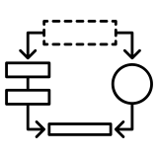






AI/Run Playbook
Innovation center
BEHAVIOR
CHANGE
Integrating AI seamlessly into existing systems and processes and maintaining high employee engagement and adaptability
People
7 pillars of AI-driven approach
SDLC PROCESS
[ENGX.AI]
AI ADOPTION
MEASUREMENT
A comprehensive and mature development process to encapsulate the best practices and standards for software development performance enhanced by AI.
Reporting on the level of AI Toolset adoption and utilization across software development teams
Processes
Innovation Center
GOVERNANCE OF
BUSINESS VALUE
AND ROI
AI EDUCATION
Understanding ongoing ROI from AI-driven software Development, prioritization of use cases, and required tools
Combination of formal and informal learning to continuously upskill employees to use AI
AI DEVELOPMENT
ECOSYSTEM
PERFORMANCE
MEASUREMENT
AI tools, agents, and platforms are integrated into a single ecosystem. It aims to provide AI-supported automated solutions to accelerate and automate development.
Establish metrics and benchmarks to evaluate and improve performance, ensuring continuous improvement and alignment with strategic goals.
Technology
Notes:
AI/Run Framework
is a strategic approach for AI adoption in software development to maximize business value and ROI. It focuses on governance, performance tracking, and upskilling through AI education, while offering tools and best practices to improve efficiency and innovation in software projects.

Slide 19
Agents Enhance Every Stage of SDLC
Functionality Clarifications
Test Case Design
Manual Tests Execution
Tests Automation
Tests Results Analysis
Tests Coverage Analysis
Grooming sessions
Architecture and Implementation planning
Tasks decomposition
Impact Analysis and Test Planning
Incoming incidents triage
Root-cause analysis
User’s support request handling
Planning
Testing
Support
15-20%
25-30%
25-30%
Ideation
Coding
Release
10-15%
20-25%
5-10%
Stakeholders Communication
Draft Requirements and User-Stories
Implementation planning
Functionality Clarifications
Feature Development
Unit tests
Contract tests
Code Review
BA/PO story verification
User Acceptance and Exploratory testing
Performance testing execution and analysis
User Story Demo
Release reporting
Legend:
Virtual Developer
Virtual BA
Virtual Team Lead
Virtual Support
Virtual QA

Slide 20












Ready to Use AI-Infused Experiences to Get a Fast Feedback
User Stories Elaboration
Code Reviewer
Tests Automation Agent
Helps to draft initial user-story using meetings transcripts
Aids PO in preparing for grooming and implementation review sessions
Speeds-up creation of acceptance criteria for user-stories
Reacts on new merge request created and starts review without any delay
Comment on areas for improvement according to coding standards used in the team
Analyze and improve unit test coverage
Can be called from IDE before pushing changes
Test script in appropriate OOP and TAF.
Create required Data for existing test automation framework.
Integrate assistant with Git, Jira other tools
Educate assistant on coding standards and processes for automated test development
Tests Analysis & Planning
Code to Documentation
Support Assistant
Create a strategy of testing for user-story
Collects required information and identify requirements gaps
Creates test cases based on defined format
Conduct test execution analysis to uplift test coverage based on defects
Reads code of your repositories, analyses and create a graph of dependencies
Creates technical documentation from code as well as user documentation on exposed features
Provides AI powered code assistant as a side product of documentation generation
Receives support requests through convenience channels such as email, team, webchat, etc.
Answers the request by searching information in available data
Helps users create support requests and track the progress

Slide 21
Agentic AI Ecosystem Maturity Capability Model
 | Complexity Factors |  | Level 1: Experimental | Level 2: Operational | Level 3: Strategic
Channels Integration | Behavioral shifts across teams Integration channels diversity Role-based customization | Standalone Assistants
 |  | Embedded Assistants
 |  | Unified Experience
Agents Management | Agent Operating Modes (sync, async, event-driven, etc) Observability Access Control Workflow orchestration | Team-Owned Agents
 |  | Shared Agent Library
 |  | Agent Platform
Context Engine | Content types and formats variety Data pre-processing and normalization Search & Rank Memory | Static Data
 |  | Dynamic Information
 |  | Semantic Knowledge
Evaluations | Use-case based testing strategies Evaluation infrastructure Test benchmarks and data sets management | Ad-hoc Quality Checks
 |  | Structured Testing
 |  | Systematic Quality Controls
LLMs | Multi-Model Complexity Vendor Landscape Evolution | Unguided Usage
 |  | Model Hub
 |  | Intelligent Model Routing
Governance & Compliance | Regulatory Alignment Risk Management (security, ethics) Usage Analytics & FinOps | Ungoverned Adoption
 |  | Manual Controls
 |  | Enterprise Compliance Suite
Channels
Integration
Agents
Management
Context
Engine
Evaluations
LLMs
Governance
& Compliance

Slide 22







AI-First Delivery Teams
Stay in Motion
Approach Highlights
Day-1 AI Fluency Every role is certified and 100% ai-adoption rate in sprint #0
Curate Best-fit Agentic Toolchain EPAM AI Run/CoE-backed selection of SOTA agents and copilots, refreshed monthly
AI-Optimized Work Units Optimized solution structure and role-based input tasks format calibrated for minimal human re-work
Guard-railed Quality Gates AI output passes automated security and quality gates + human sign-off before merge
Reinforcing Improvements Telemetry-driven agent tuning every sprint & templatization for max AI automation
Operating Model at a Glance
Full-SDLC AI Stack Reqs -> IDE → CI/CD → QA AI agents/assistants recommended by EPAM AI/Run CoE experts
Productivity Growing Targets ↑Throughput, ↑DORA deployment-frequency, ↓MTTR, ↑Defect-containment
Value-Stream Control Tower Deliver pipeline optimization, agent vs human mix
Transparent Metrics Discipline Dashboards, agent audit trail, ROI tracker
AI Native Pool
AI Value Stream
Engineering AI Tools Center of Excellence
Project Starter Kit
Agentic Workflows
Rules Files
Curated MCP Servers
Telemetry Dashboards
AI Optimized Work Units
Humans, Agents & Workflows
AI Output Quality Gates
Show visually:
On the left AI native pool
On the side – AI/Run Engineering AI Tools CoE
Value stream like view
Humans and Agent Workers as actors
Unit of work optimized along the entire delivery pipeline
Quality gates/AI code review and acceptance
Re-usable project specific templates

Slide 23
Build Business Case for AI SLDC Investment, Benefits, and ROI Calculator
Innovation center: processes
One of the primary functions of the Center of Excellence is to define KPIs and develop business cases based on thorough analysis and comprehensive discovery.
Calculation Baseline
ROI in 10 Months
Anticipated total boost of efficiency about 20%
Savings from 3rd month
Swift tangible results
Team Composition
5 functional QA
5 test automation
Accumulated cost vs accumulated savings, FTE
Monthly based costs vs savings, FTE
Selected AI use cases
Test case authoring
Test automation code authoring and scripts maintenance
Investments Details
3 months
3 FTE for AI enablement
2 FTE part-time from the project team as early adopters (Alpha group)
Sample: ROI Calculation for AI Adoption

Slide 24
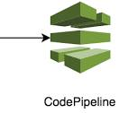

















AI Development Ecosystem with AI Run
Innovation center: Technology
Role-based channels extended with custom agents and workflows to accelerate day-to-day tasks
Developer Toolset
Messengers
Tasks Tracking
AI Run Platform
Library of agents and workflows for highly contextualized custom agents and workflows
Agents Fleets
Business Analysis
Development
Testing
Support
DevOps
Runtime
Enterprise Enablement
Custom agents runtime supporting build, test and execute phases
Integrations
Workloads
Hosting & Execution
Security
Data sources
Agents
Discovery
Auditability
Tools
Workflows
Orchestration
Observability
Curated high-quality content with removed noise and gaps as pre-requirement for quality output
Curated High Quality Context
Models and data connectors for integrating and extending project toolset
LLM providers
Data providers
Notes:
Dima
Collaboration
Integration Extensive Library of Tools: VCS, codebase management, research, cloud integration, Jira, Confluence, open APIs, notifications, and data management.
LLM
Workflow

Slide 25
Examples of Agents
Innovation center: Technology
Draft Requirements Agent
Test Case Agent
Test Case Automation Agent
Unit Tests Agent
Scope:
Draft user stories in Rally
Standardize stories format
Enable Dev/QA to get an answer from BA/PO faster by querying documentation/codebase
Solution Highlight:
Load context from Rally, Confluence, SharePoint
Get a Teams call transcript and create a summary
Suggest epics/features/stories list based on the summary
Create Rally stories for the approved items
Scope:
Augment test case generation process with AI agent, to increase efficiency of test case generation
Minimize operational overhead of working within multiple tools (Rally, QTest) by enabling chat interface to create TCs
Solution Highlight:
Integrate assistant with Rally and QTest
Integrate assistant with Confluence as additional data source
Tune assistant on expected Test case format and all required fields in Rally / Qtest to support traceability between requirements and test cases
Scope:
Support automated testing engineers with generation of code for new automated tests using AI
Aid engineers with supporting assistant for updating existing test
Solution Highlight:
Create required Data sets / Class Diagrams for existing test automation framework(s)
Integrate assistant with GitHub, Rally and QTest
Tune assistant on coding standards and process for automated tests development
Provide access to assistant through IDE
Scope:
Minimise time required on Increasing Unit Tests Coverage in new and legacy code
Avoid bugs when changing the code
Solution Highlight:
Adjust the agent for project specific codebase
Generate Missing Unit Tests
Offer quality gates that reject generated tests failing to enhance code coverage or adhere to the defined standards of well-written unit tests.
The tool is integrated into the CI/CD pipeline to become part of the development lifecycle.

Slide 26


Team Level AI Maturity Model
EPAM AI/Run
Required Org Capabilities
Outcomes for Team
Outcomes for Organization
L3 AI-Native Team
Enterprise AI Ecosystem with Self-Service Agent Factory
Cross-roles/T-shape training and upskilling (Manual QA to BA, or Front-End Developer to Full Stack, etc.)
KPIs
Next-generation innovative PDLC, culture rituals, ideation, and feedback loops processes
AI automates most of the repeatable and low complexity workflows
Innovative AI-Native PDLC
Federated agent marketplace
Next-generation talent development framework
Enterprise AI Ecosystem with self-optimizing PDLC
Time-to-Market
L2 AI-Enabled Team
AI Agent Platform with shareable artifacts and agents created on request
Rewards and recognition system
Performance measurement dashboards
KPIs
AI Agents are set up for all team members and automate routine workflows
Most of the day-to-day output of team members is produced together with AI
AI adoption and performance impact are measured and used to drive adoption
Community of AI Champions
Enterprise library of prompts, agents, workflows, and MCP servers for standardization and reusability
Library of case studies for ROI calculation
Must: Individual Performance
Should: Team Performance
L1 AI-Engaged Team
Licenses for Market AI Tools
AI Literacy trainings
AI Tools usage guides
AI Adoption dashboards
KPIs
Teams are enabled to use AI Tools to support day-to-day activities
Adoption of AI tools is measured
Feedback on tools
Feedback on training
Early adopters to become AI Champions
Engagement Rate
Acceptance Rate
Notes:
Last Update date: Aug 14 Slide Owners: Thought Leaders: Tatsiana Hmyrak / Aliaksandr Paklonski
Senior Practitioners: Tatsiana Hmyrak / Aliaksandr Paklonski

Slide 27


New Ways of Working: AI Native Development
Agentic Project Teams
Developers / T-Shaped
QE / T-Shaped
Implementation
Quality Assurance
Data Sources, Format, DoD
Test Cases,
Gherkin Format,
Test Data source
Plan/Scaffold - HOW it should be done
IDE Dev Agent
CLI Coding Agent
Background
Dev Agent
QA Agents Fleet
Tech Lead
Solution Design
Deployment
Developers /
T-Shaped
Sketch - WHAT should be done
Recipes, Runbooks, Terraform Format
SA Agent
DevOps Agents Fleet
T-Shaped Engineer
BA
Agents Fleet
Project Mgmt
Agents Fleet
Requirements
Release
Data sources, Story Format, Context, DoR
Release Format, Target Environment
Shared Agents Fleet
Product Owner
Agentic Semantic Knowledge Layer (Context Engineering)
Scrum Lead
Notes:
Last Update date: Aug 28 Slide Owners: Artem Pak / Alena Zakharyeva / Dmitry Tovpeko Notes from Tanya: 1. consider adding UX Designer role
2. Consider using Hats instead of roles and show separately that 1 hat can be covered by multiple roles based on load, e.g. BA role can be 70%-100% done by any other role
3. Do we want to add background agents as next level?

Slide 28



Success of AI Adoption Measurement
Innovation center: People
EPAM propose well defined and holistic success measurement methodology, which enables performance measurement on individual, team and organizational level.
It consists of distinct levels of measurement : Engagement > Adoption > Individual Performance, Team Performance, where each subsequent step replies on the previous one as a prerequisite.
Establish DORA, SPACE and AI contribution metrics tailored specifically to measure the impact of AI adoption at multiple levels — from individual engagement to overall team performance. Metrics will span user engagement, tools usage, interaction with defined use cases and acceptance, the number and quality of AI-generated outputs, individual productivity enhancements, and team-level improvements, including velocity, cycle time, and AI contribution to the overall codebase.
Proposed KPIs and мetrics for defining and measuring success
Approach to establishing baselines
Baseline data reflecting current performance, productivity, and engagement levels before AI adoption. This includes historical analysis of development and testing cycle times, story/test creation durations, time spent in development, testing, PR acceptance rates, code review timelines, and existing productivity insights. Initial surveys and self-assessments will be conducted with users to gauge their AI proficiency and readiness.
Customized real-time dashboards designed to track and visualize AI usage and impact in real-time. Weekly and monthly includes detailed tracking of engagement, adoption, productivity metrics, and team-level outcomes. Automated and periodic surveys will complement these quantitative reports by capturing qualitative user experiences and insights, allowing prompt identification and resolution of adoption barriers and challenges.
Monitoring and reporting methodologies
Continuous improvement process
Continuous improvement will be integral to AI adoption strategy. Regular training sessions, best practice showcases, and tailored coaching will ensure sustained growth in user proficiency. Additionally, insights gathered will directly inform iterative updates and enhancements of AI tools and workflows, continuously optimizing their effectiveness and alignment with user needs.

Slide 29
Four-Dimensional AI Adoption Measurements Approach
Innovation center: People
Requirements Gathering
Design & Planning
Implementation & Testing
Deployment & Maintenance
Lead Time
Value Stream Performance
Requirement Preparation Time
Cycle Time
Deployment Time
Development Time
Testing Time
Business Analysis
# of Stories Created
Time for Sprint Backlog definition
Quality Of Sprint Backlog
Time for Onboarding Material and Glossary Creation
Time for Personas Creation and Definition
Developers
Velocity
Average Code Review Time
Code Review Failure Rate
Unit Test Coverage
Technical Debt
Average Rework Time per Defect
Automation and Manual QA
Test Development Velocity
Test Coverage
Test Automation Effort
Test Effectiveness
Test Result Analysis Effort
Defect Leakage
Role-Based
Individual Performance
AI Adoption
Adoption Stats
Engagement Rate
Usage Rate
# of Inactive Users Last X Days
Prompts Acceptance Rate
Lines of Code Generated
% of Chat Users
Engagement Score
Self-Proficiency Rate
Performance Rate
Disruption Rate
Time Savings
AI Relevance Score
AI Adaptation Effort
Engagement

Slide 30
Monitoring and Reporting Methodologies
Innovation center: People
Team Performance
Team performance in delivering product features is changing positively.
Leverage existing productivity and DevOps dashboards (Jira, Azure DevOps, GitHub Insights).
Regular aggregated team performance review meetings or status reports to assess and adjust adoption impact.
Individual Performance
Individual performance to create output is changing positively.
Track and report time spent on story/test case creation via integrated tools like Jira, GitHub or productivity tracking tools.
Measure flow metrics specifically focusing on time spent in certain activities in SDLC
AI Adoption
The output of individuals is changed, and AI plays a significant role in creating it.
Monitor adoption through continuous logging of AI-generated outputs (# of stories, test cases).
Use automated reporting for frequency of AI-driven activities and interactions.
Analyze and report time savings achieved through AI usage per identified use case.
Engagement
Individuals regularly
interact with the AI Tools
in a meaningful way.
Setup AI Adoption interactive dashboards for weekly tracking of engagement trends, usage and tool interaction (tokens generated, frequency of tool usage per individual)
Periodic surveys to measure user satisfaction and engagement quality.
Detailed breakdowns of usage rates segmented by user roles and solutioning areas.

Slide 31
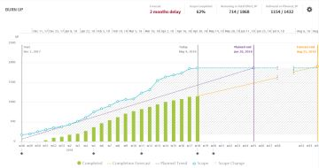






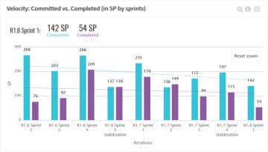







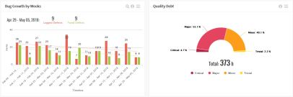

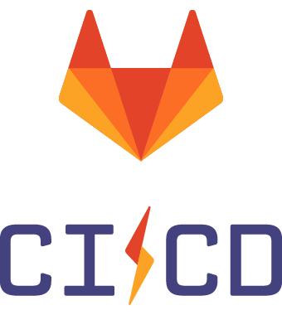

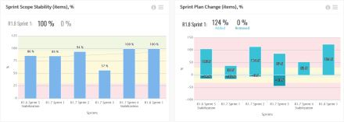
Monitoring of key metrics per project and team to provide all necessary information to drive improvements process and measure outcomes
Innovation center: People
Work Management
Metrics Data Model
Are we on track?
Work Management
Azure Boards
Source Code Mgmt.
Code Quality
Code Quality
How reliable are team commitments?
CI / CD
Metric Calculators
(120+ OOTB)
Source Code Management
How efficient is the testing?
Load data
Delivery Forecast
Defect Leakage
Quality Debt
How good we are about planning?
Build & Pipeline
Commitment Rate
Feature Lead Time
Custom Connectors
via TelescopeAI Professional Services
and so on
Pipeline Red Time
…..

Slide 32
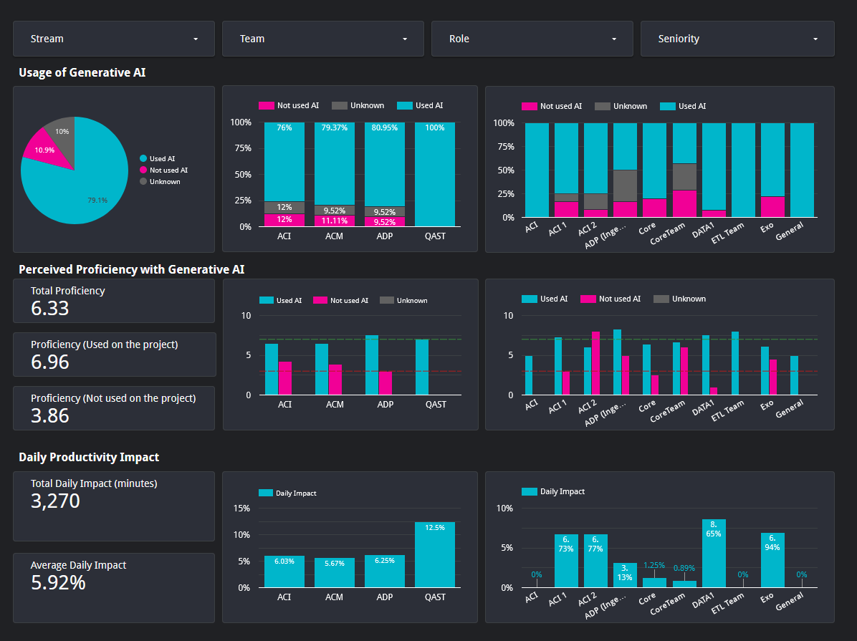
AI Adoption Engagement
Innovation center: People
Clients’ feedback quotes:
“It has become working much faster.”
“Helpful in generating new ideas. Good tool for newly onboarded BA – useful to start smoothly on the project.”
“Great starting point, especially for the onboarders or junior BAs”
“I plan to use it on full strength for the work on next Epic”
“Helps to save time for creation and modification of the User Stories.”
Notes:
The AI Adoption Dashboard is a crucial tool for organizations aiming to harness the full potential of AI in their engineering processes. This intuitive dashboard offers:
User Engagement Metrics: By quantifying the number of team members actively integrating AI into their workflows, leaders can identify both pioneering adopters and those who might benefit from additional guidance or training.
Proficiency Analysis: Understand, at both individual and team levels, the depth of AI tool mastery. This aids in pinpointing where further training or support is most needed, ensuring that all members are optimally leveraging AI capabilities.
Productivity Impact Assessment: Track the real-world benefits of AI adoption, measuring factors such as time savings, increased accuracy, and overall efficiency improvements.
This comprehensive dashboard provides a transparent and strategic view of AI's evolving role within the organization.
Enhanced monitoring capabilities allow users to track usage statistics with selectable metrics and timeframes, providing deeper insights into application performance and usage patterns..
User Adoption: By quantifying the number of teams and users actively integrating AI into their workflows. Metric like:
Number of teams using AI
Active Users over time
Prompt / Data Sources / LLM calls
Tokens in and out collected by calculating
Topic of requests collected using LLM
Response Accuracy: Advanced metric quantifying the relevancy of AI predictions. Metrics like:
Relevancy collected using LLM
Reliability collected using LLM
Prompt quality collected using LLM
Sentiment collected using LLM
User Satisfaction
User’s satisfaction collected with surveys
Net promoter score collected through feedbacks on ELITEA UI

Slide 33
Continuous Improvement Process
Innovation center: People
Team Performance
Implement regular retrospectives (weekly/monthly) to analyze team-level data, identify bottlenecks, and recommend improvements. Ion ways of working.
Foster peer-to-peer knowledge sharing sessions and internal showcases of successful AI
Recognize and incentivize teams demonstrating high performance improvements to sustain momentum and encourage continuous engagement with AI tools.
Individual Performance
Conduct regular retrospectives (daily/weekly) to address individual productivity blockers, incorporate suggestions for agent improvement and use case elaboration
Regular one-on-one coaching sessions to optimize individual productivity leveraging AI tools.
Encourage individuals to share personal productivity improvements and best practices during regular AI Office Hours, fostering a community of continuous learning.
AI Adoption
Implement incremental improvement cycles, refine agent configurations, and promptly apply updates.
Promote internal showcases and case studies highlighting successful AI-driven adoptions across teams.
Regular tuning of AI agent capabilities with champions based on user feedback and metric insights.
Provide targeted support sessions and interventions for individuals or teams facing adoption challenges.
Establish a continuous feedback loop by regularly collecting user insights to identify barriers to sustained engagement.
Address challenges and identify opportunities for improved interaction.
Regular user workshops and coaching sessions focused on improving tool proficiency and maximizing engagement.
Regularly refresh and communicate new AI use cases and success stories to maintain ongoing user interest and motivation.
Engagement

Slide 34

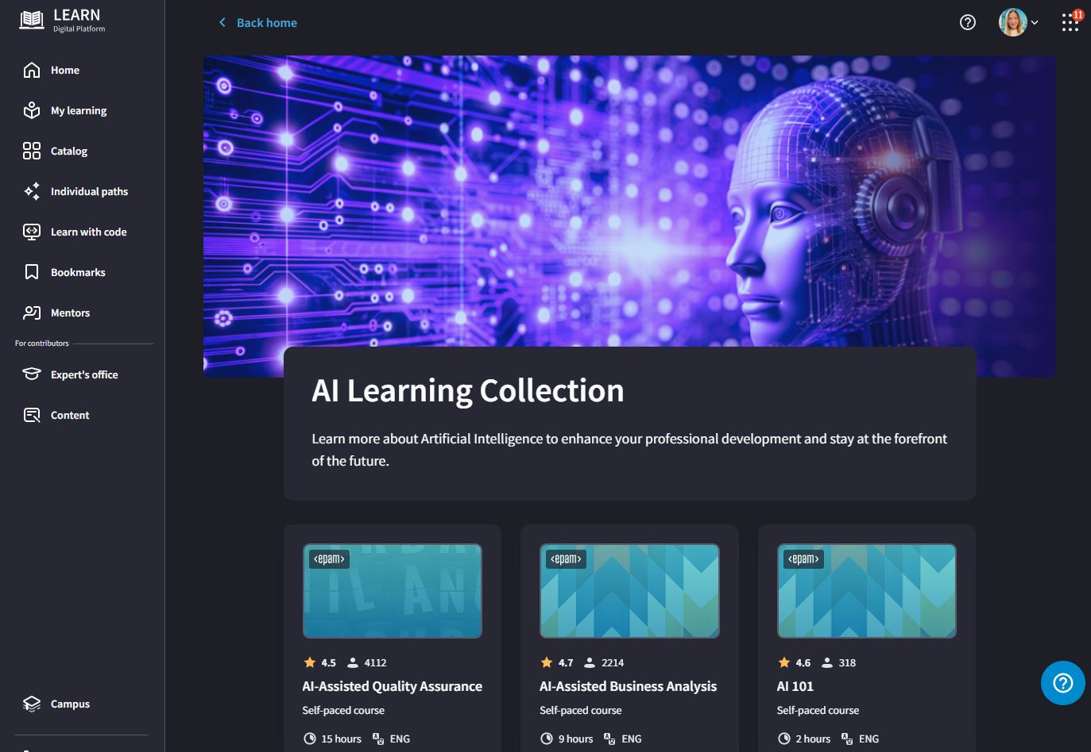

AI Education and Engagement
Innovation center: People
Formal Learning
EPAM offers a comprehensive industry-recognized AI Education and engagement program to ensure that every employee continuously has sufficient skills to use GenAI daily while understanding the associated risks and limitations.
AI Literacy Courses are focused on building foundational skills and understanding of GenAI across all employees:
Generative AI Fundamentals
Prompt Engineering Fundamentals
Role-based AI Education is focused on providing every person with the knowledge and skillset required to execute role-specific day-to-day activities using the GenAI toolset to boost productivity:
AI-Assisted Software Engineering
AI-Assisted Quality Engineering and Test Automation
AI-Assisted System Engineering
AI-Assisted Product Management
Informal Learning & Engagement
Social Learning allows us to engage all employees in the promotion of AI-related knowledge and skills:
The AI Ambassador Program aims to continuously empower active individuals to share AI-related knowledge on a scale from a team to an organization.
AI Games event brings the attention of all employees to the importance of AI-related knowledge and provides a space to learn and experiment.
EPAM LEAP platform provides a single-entry space for all knowledge related to the existing AI toolset, and its influence on SDLC, and provides a safe space to experiment.
Notes:
AI for SDLC Rollout & Business Case – the creation of AI for SDLC strategy for the client organization.
AI Education & Engagement – a combination of formal and informal learning to upskill the client workforce with fundamental AI Literacy and role-based and tool-specific training.
EPAM GenAI Agentic Development Ecosystem – creating an integrated GenAI agentic environment to boost the productivity of every employee.
GenAI Adoption & Impact Measurement – client employee coaching focused on adopting and efficiently using GenAI tools with real-time measurement of productivity gains.

Slide 35




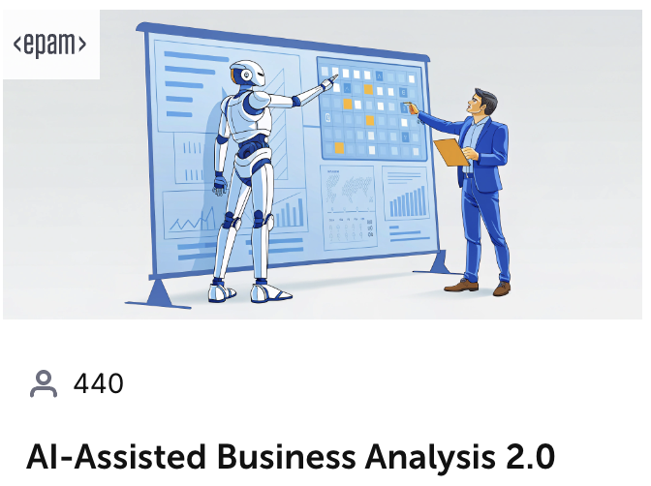
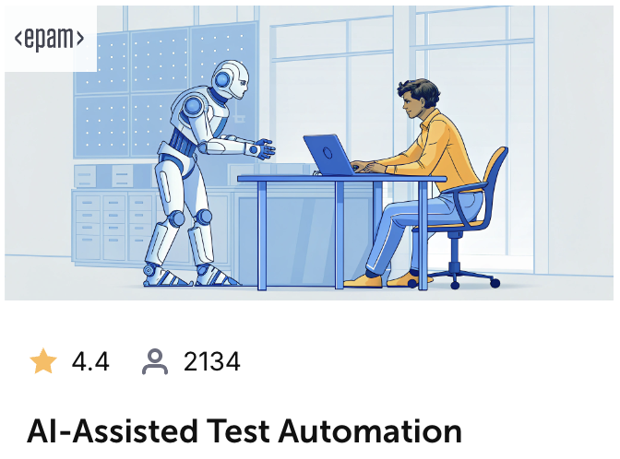
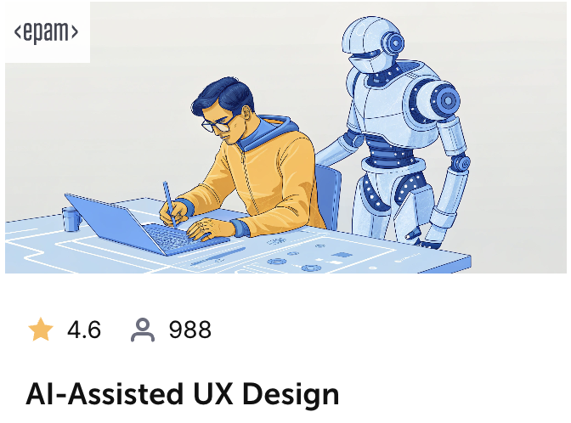
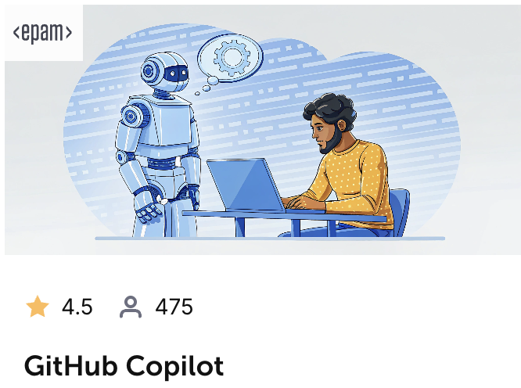



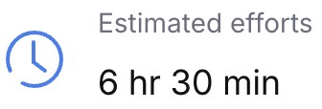



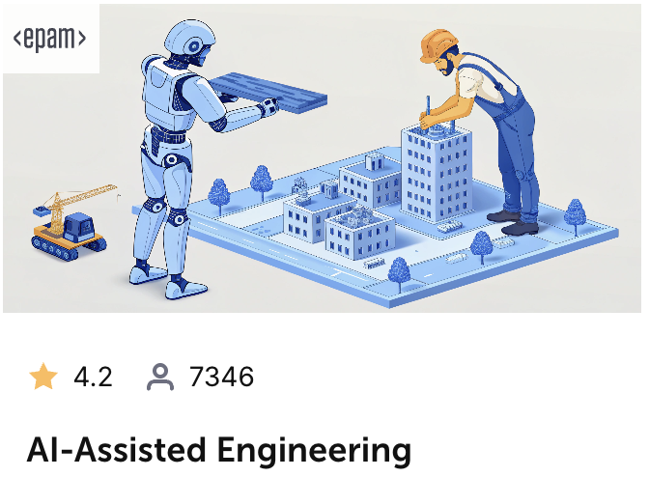
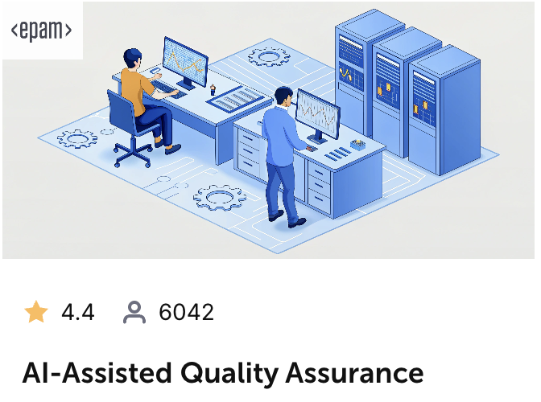
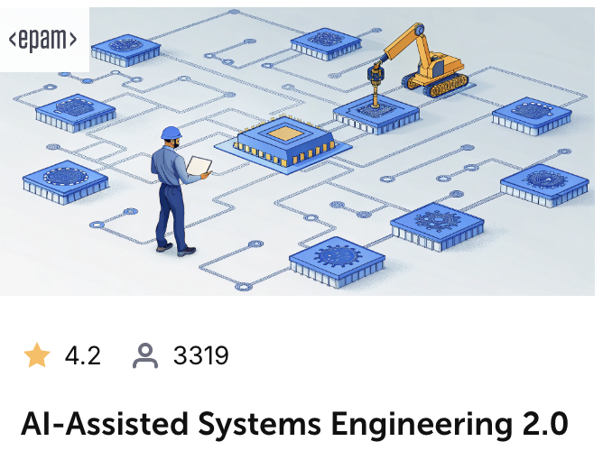
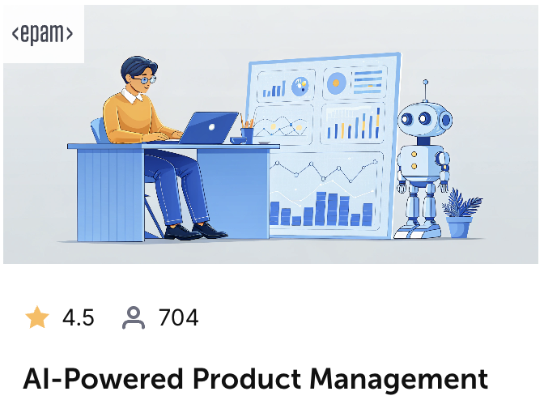


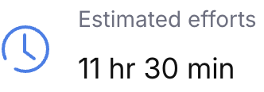




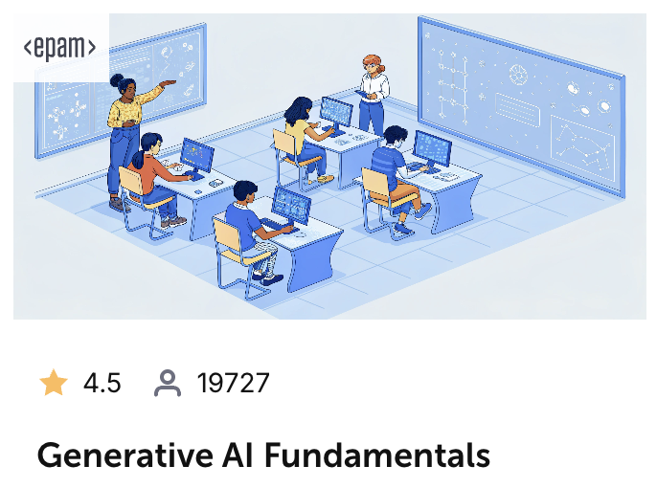
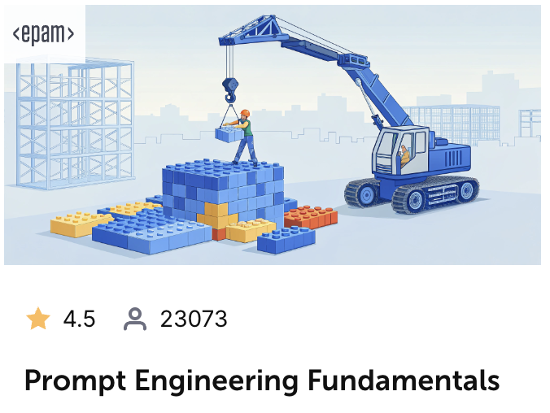
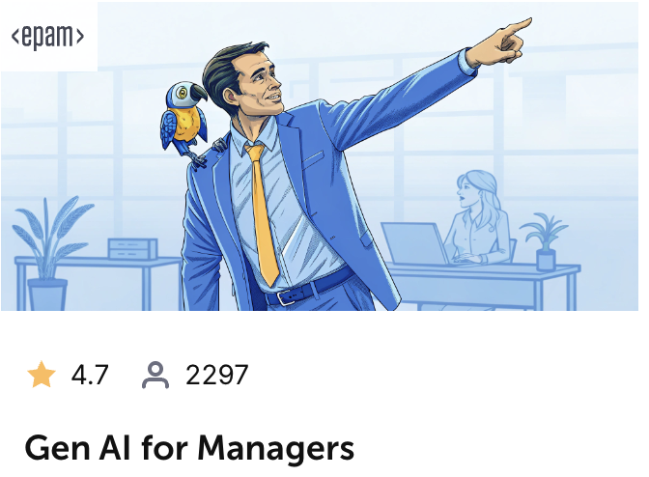
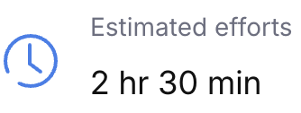
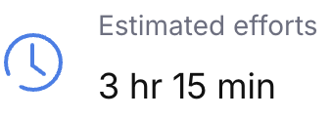

The AI Upskilling Training Program
Innovation center: People
AI Adoption for SDLC
AI Literacy
number of participants
average rating
AI skill
Notes:
The AI Upskilling Training Programs are designed to continuously provide employees with a top-notch set of knowledge and skills to stay ahead of GenAI disruption and market demands.

Slide 36
Role-Specific AI Educational Offerings
Innovation center: People
Self-paced E-learning materials focusing on the application of AI skills within specific job functions and roles. All courses are based on EPAM’s high-quality internal training materials.
Sample Role-based Courses
AI-Assisted Business Analysis | Audience: Business Analysts, Systems Analysts, Product Owners Objective: Equip business analysts and related professionals to leverage AI-driven solutions throughout the Software Development Life Cycle (SDLC). The course provides a detailed exploration of applying conversational AI to enhance business analysis practices.
AI-Assisted Quality Assurance | Audience: Testing Engineers Objective: Equip testing engineers with knowledge and techniques to incorporate LLM usage into existing software testing processes. The course focuses on optimizing everyday testing tasks with conversational AI tools.
AI-Assisted Test Automation | Audience: Test Automation Engineers Objective: Equip test automation engineers to incorporate LLMs into new and existing test automation frameworks. The course focuses on practical techniques and best practices to empower and improve test automation.
AI-Powered Product Management | Audience: Product Managers and related roles Objective: Equip product managers to support, evaluate, and apply generative AI solutions appropriately. The course covers a range of AI concepts and techniques tailored for effective product management.
AI-Assisted Engineering | Audience: Software Engineers Objective: Equip engineers with knowledge and techniques to work with LLMs and seamlessly integrate them into their development practices. The course explores practical use cases that can accelerate delivery and improve performance.
AI-Assisted Systems Engineering | Audience: Systems Engineers Objective: Equip systems engineers to select and apply conversational AI techniques across a broad range of systems development processes. The course presents a wide variety of use cases and best practices.
AI-Assisted UX Design | Audience: Designers Objective: Equip UX designers to create intuitive and user-friendly designs leveraging conversational AI. This course covers the application of AI in various stages of UX design, including user research, prototyping, usability testing, and interface design.
Prompt Engineering for Managers | Audience: Project Managers, Delivery Managers, Team Leads Objective: Equip managers with delivery-focused AI use cases and practical insights for improving processes, decision-making, and innovation with AI. The course also focuses on ethical and responsible AI implementation.
Notes:
One-page Version

Slide 37


Hands-on AI Coaching
Innovation center: People
Successful adoption of Generative AI across employees requires careful and well-thought coaching to prevent and overcome initial hesitation and frustration. Our combined approach includes coach-driven trainings and workshops with regular in-flight hands-on activities.
AI Related Activities During Regular PI
Week 1 | Week 2 | Week 3 | Week 4 | Week 5 | Week 6 | Week 7 | Week 8 | Week 9 | Week 10 | Week 11 | Week 12
Sprint 1 |  | Sprint 2 |  | Sprint 3 |  | Sprint 4 |  | Sprint 5 |  | Sprint 6
On demand ongoing hands-on Q&A and “pair-programming” sessions
AI Learning Journey
High-quality learning materials to provide initial knowledge about Generative AI and its applicability for software development related tasks.
Weekly AI Coffee Breaks – guilty-free informal space for participants to share experiences with Generative AI and opportunity to learn from each other's successes and failures.
AI Workshops
Bi-weekly AI Retrospectives – more formal session to highlight the productivity improvements, adoption success and failures. Review AI Adoption impact on various aspects of SDLC and possible process improvements.
Hands-on workshops driven by coaches to show how Generative AI can be applied to specific software development activities on the project.
Monthly AI Day – a chance to focus whole day on learning new ways Generative AI can be applied to usual tasks, get support from coaches and report findings.

Slide 38

AI Champions
Innovation center: People
Drive AI Initiates
Foster AI Culture
Scope:
advocate for best practices
promote knowledge sharing
ensure AI is naturally embedded into day-to-day activities and operations.
Profile:
target already engaged senior engineers and managers
hands-on practitioners
individuals with motivation to experiment and drive change
those ready to educate and influence their peers
Time Commitment:.
majority of the time should be integrated seamlessly with daily responsibilities
allocate several hours a week for AI research and experimentation
Scaling:
encouraging cross-team collaboration
cultivating innovative thinking
promoting continuous learning
developing efficient processes
Knowledge Hub:
acting as knowledge hubs
sharing experiences
promoting best practices
Professional Development:
upskilling themselves & others
contributing to professional growth
building & refining AI skills
enhancing career prospects
Responsibilities
Benefits
Use Cases, Tips & Tricks, Tools, Processes, Knowledge Base, Professional Development, Scale

Slide 39
Maximizing AI Adoption in Enterprises Through Effective Organizational Change Management
Innovation center: People
TRACKING
&
MONITORING
AI
COMMITTEE
AI
CHAMPIONS
Governance ensures responsible and ethical AI use within the organization. It sets clear AI policies, guidelines, and standards, defines roles, manages data privacy, and ensures accountability and transparency.
Ensures accountability and transparency
Includes reporting and stakeholder meetings
Ensures AI usage transparency
Manages risks and legal compliance
Aligns AI with organizational goals
Builds trust and ensures AI initiative sustainability
Governance& Monitoring
AI
COMMUNITY
Engagement System
Community & Knowledge Sharing
AI
RESISTANCE
WORKSHOPS
RECOGNITION
KNOWLEGDE
SHARING

Slide 40

Value We Bring to our Clients
Innovation center: People
INCREASED PRODUCTIVITY
INCREASED PRODUCTIVITY
Cost Savings
Implemented end-to-end AI-driven automation for unit test generation, increasing test coverage from 16% to 46% in a single run.
The Elitea solution enhanced BA and QA productivity, achieving a 62% boost in user story development and a 53% increase in test case generation and automation efficiency.
The EPAM GenAI consulting team established foundational GenAI capabilities and an impact measurement framework, delivering $1.1M ROI and a 10% boost in team velocity.
US e-commerce company
Multi-brand retailer
Unit Testing Automation AI Run Agents
Acceleration with AI Run Agents
Engineering AI Adoption
INCREASED PRODUCTIVITY
Cost Savings
WORKLOAD REDUCTION
Observed a 15–35% faster delivery of automated test cases due to AI-powered accelerations.
Implemented agentic workflow on EPAM CodeMie platform to analyze 100 app instances, enabling migration planning and achieving $74.5K savings within 3-5 months.
Enabled GenAI-driven modernization of legacy platforms, including code exploration, reverse engineering, migrations, and enhanced unit and automated test coverage.
Internet of Things company
Insurance payment provider
Health technology company
Managed Services
Projects Delivery with AI Run Agents
Modernization with AI Run Agents
Notes:
1. US e-commerce company (Wayfair), WAYF-UTPC 2. Multi-brand retailer (Canadian Tire), CTCO-EPE 3. EBSCO, EBS-SPEC 4. IoT company (Relayr) 5. Insurance payment provider (OneInc), OI01-GAI 6. Health technology company (Philips)

Slide 41
AI Adoption Timeline
Typical AI Adoption Timeline
Phased AI Adoption Process

Slide 42



Typical AI Adoption Timeline
AI Adoption timeline
Phase I: Crawl
Phase II : Walk
Phase III: Run
CREATE A MOMENTUM
ENABLE TO SUCCEED
DRIVE YOUR OWN EXCELLENCE
0-6 months
6-12 months
12-24 months
Design the future state and prepare it for future Continuous Improvement
Enable Client to transform while carefully building the required capabilities
Hand over the steering wheel to Client to sustain changes and continuously improve
Discover existing operating model, technical capabilities, and engineering practices
Establish Prioritized CoE(s) to support IT organization objectives
Formalize Platform Engineering Function
Build prioritized Platform Technical Capabilities
Pilot Adoption for 1-2 selected teams of prioritized Platform Technical Capabilities
Formalize enablement function
Adopt Continuous Improvement Program for selected teams
Continue improvement of CoE(s) and the Platform Technical Capabilities to support organization objectives
Mass rollout adoption of target IT Operating Model for the rest of the organization
Embrace and Support Continuous Improvement Culture with Client
Reallocate resources to move Client ownership of the Foundation Platform
Involvement/Expertise
Client ownership
Notes:
Focused transformation journey

Slide 43





Getting Ready for Crawl Phase: Pilot Approach
AI Adoption Program Objectives
Crawl Phase Readiness
AI Adoption Workshop: The Pilot
Outline AI Use Cases
Define AI Ecosystem
Identify Trainings
Establish Governance
Select Pilot Teams
APPROACH:
Review value stream
Identify top time-consuming activities
Outline repetitive tasks
Catch easy to automate tasks
APPROACH:
Define key success metrics
Select AI tools
Define AI adoption roles
APPROACH:
Gauge current level of AI literacy
Assess existing AI training
identify additional upskilling needs
Evaluate the need for Centers of Excellence
APPROACH:
Outline reward strategies
Identify involved AI change personas
Develop a communication and change plan
CRITERIA:
Healthy delivery process
Metrics baseline available
Representative backlog of what to expect at scale
No near-term delivery pressure
Named candidates for AI champions

Slide 44
EPAM’s Expertise & Experience in End-to-End SDLC Capabilities
03

Slide 45





AI Run - Collaboration Platform for Teams
USER INTERFACE AND EXPERIENCE
Integrate AI Agents and pipelines into common interfaces, such as chat, emails, IDEs or even to your websites to support your clients or users
AIIA EXPERIENCES
AGENTS AND PIPELINES
WORKFLOWS
Automate workflows using AI Agents and Pipelines to get the most out of selected use-cases
AI ASSETS MANAGEMENT
Every user and teams create, update, version, test prompts and data sources to easily experiment and collaborate
PROMPTS AND DATA
PROJECTS AND USERS
TEAMS
User and team management with advanced RBAC and data level isolation to work in secured way
AI MODELS GOVERNANCE
LLM ACCESS
Connect AI model provider of your choice or use privately hosted models to unify and simplify access

Slide 46
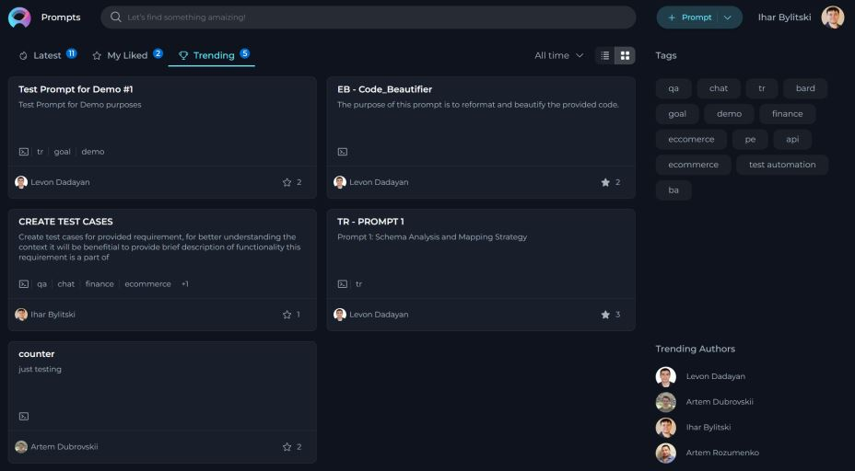
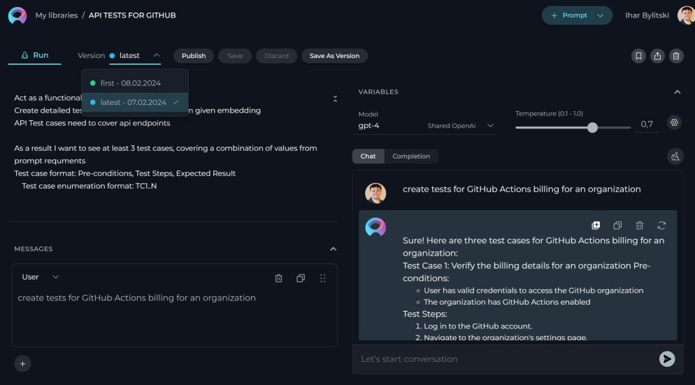

Prompts and Data Sources
Space designed to create prompts, data sources, collections and organize them.
Create, Modify, and Save Prompts: Users can now create, modify, and save their prompts in a dedicated space, streamlining the prompt management process.
Import Prompts: Seamlessly import prompts from EPAM AI DIAL, the previous version of EliteA™, ensuring continuity and ease of transition.
Version Control: Maintain various versions of prompts in one place, with the capability to effortlessly switch between them.
Execution Options: Execute prompts using Chat or Completion options, allowing users to gather and save the output (results) efficiently.
Publish and Share Prompts: Publish your prompts and share them with your project and network, fostering collaboration and knowledge sharing.
Engage with Published Prompts: Use published prompts and collections, with options to like them and mark them as favorites, enhancing community engagement.
Organize with Collections and Tags: Group your prompts into Collections and categorize them with Tags for better organization and accessibility.
Advanced Search Functionality: Enhanced search functionality to quickly find your prompts or public prompts and collections with various parameters.
Data Source Configuration: Set up various data sources and configure them to enhance your results and the possibilities in using Generative AI.
Embedding Creation: Users can create Embeddings, adding a layer of sophistication to prompt management.
Similarity Search and Deduplication: Perform similarity searches and deduplicate content, ensuring the uniqueness and relevance of prompts.
EPAM Proprietary & Confidential.
46

Slide 47
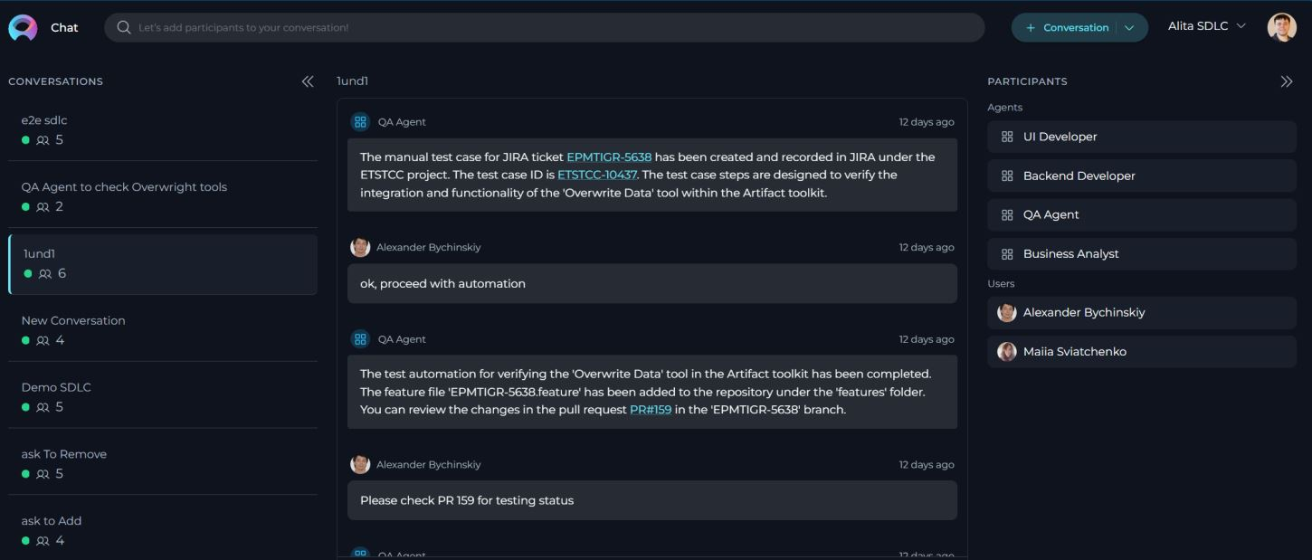
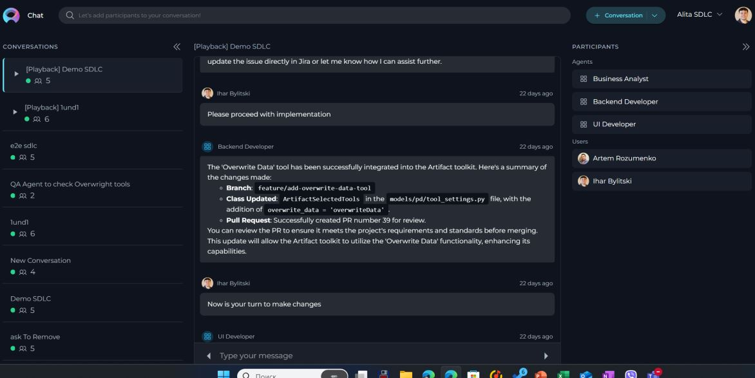
Conversations
AI/Run - EliteA™ Chat is an ultimate feature, allowing you to combine all EliteA™ features in one place and achieve the best output and results.
Conversations support the following functionality:
Public and Private Conversations: Share your conversation with other users from your project, involve them in the same conversation, or keep it private and visible only to you.
Participants: Add various participants to the conversation, including other users in public conversations, prompts, data sources, agents, and language models, making them part of the conversation.
Interactions: Interact with added participants, copy generated responses, and more.
Managing Conversations: Save conversations, pin the most important ones at the top of the screen, make private conversations public, delete conversations, clean the content of the conversation, and export the context of the conversation.
Playback: During playback, you can move backward and forward through the playback process or stop the conversation by simulating the current conversation without any engagement with models.
EPAM Proprietary & Confidential.
47
Notes:
Ihar

Slide 48

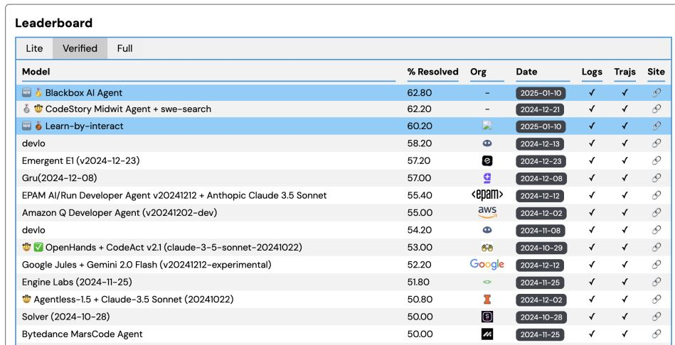
EPAM AI/Run Agent Ranked in the Top 7 on SWE-Bench Verified
Key Achievement
EPAM AI/Run Developer Agent scored 55.4% on SWE-Bench Utilizing Anthropic Claude 3.5 Sonnet
Secured a top 7 position in a highly competitive field
Outperforming major tech giants like Amazon and Google
Performance at State-of-the-Art (SOTA) level
Demonstrates EPAM's competitive edge in AI Agents development
EPAM AI/Run CodeMie:
1 alternatives for issue fix
1 SWE Bench run costs ~$600-700
CodeStory/devlo/Emergent:
3 alternatives for issue fix (they try to choose the best option with higher scoring)
3 SWE Bench run costs ~3x higher than EPAM AI/Run (due to 3 alternatives and additional comparison)
Gru/Blackbox AI Agent:
1 alternatives for issue fix with own tooling
1 SWE Bench run costs ~2-3x higher than EPAM AI/Run
EPAM Proprietary & Confidential.
48
Notes:
Ihar

Slide 49
AI/Run Success Stories
Agentic Project Teams
LEADING FINANCIAL & ANALYTICS COMPANY
MEDICAL TECH & HEALTHCARE SOLUTIONS PROVIDER
LEADING DUTCH MAIL AND ECOMMERCE COMPANY
Large Scale AI Adoption
Scaled Agentic SDLC
Agents Modernize Legacy
AI Native Delivery Transformation
Implementing the AI/Run™ framework to scale AI code assistant adoption across 90+ development teams.
GenAI Evaluation and Adoption Program across 80 engineer teams and 400+ engineers leveraging AI code assistants and custom agents.
Enabled GenAI-driven modernization of legacy platform, including code exploration, reverse engineering, migrations, and enhanced unit and automated test coverage.
Scaled AI adoption program across 10+ teams: integrating 20+ AI-powered agents to automate key development tasks and expedite time-to-value.
10% teams’ velocity improvement
↓ 30% dev cycle time
↓60% migration time
30-50% faster release cycles
X2 accepted pull requests
$1.7M ROI in 1 year
4X migration effort optimization
30-50% less defects
50 mins saved daily
↓80% planning effort
60%-80% time optimization on routine tasks
100% dependency coverage
Effort Optimization
Accelerated Time-to-Value
Scaled AI adoption program across 10+ teams: integrating 20+ AI-powered agents to automate key development tasks and expedite time-to-value.

Slide 50





Internet of Things company
Using GenAI to reduce technical debt
Increate test automation coverage
Augmenting testing with Gen AI
EBSCO Folio is an open-source Library Service Platform. It supports core library management functionality across domains including circulation, cataloging, acquisitions and electronic resource management.
Goal: Automate 1000 end-to-end UI test cases to increase automated tests coverage and reduce test cycle time.
Solution: EPAM proposed to use AI for test case automation to increase speed and reduce cost of implementation
The client has an industrial equipment monitoring and planning platform designed to provide insights and tools to prevent unplanned downtimes.
Goal: Swiftly increase tests automation code coverage, while maintaining high quality of code and short test cycles.
Solution: EPAM implemented set of Assistants for engineers to analyze, script and review automated tests. Final quality gate is human review to review implementation
Lenovo order fulfillment is an API first service to fulfill product orders from Lenovo and partners like Norton and Dropbox
Goal: improve productivity of QAs by augmenting creation and updating of test cases and automated tests using GenAI
Solution: EPAM Implemented AI Agent that reads the swagger specs and create/updates tests cases based on changes, as well as making changes in automated tests and propose the pull request(s) with updates
20% faster
than manual automation
35% cheaper
than classical team
+65% coverage
on critical path for 2 months
30% faster
regression testing cycles
40% less time
on test cases operations
30% less time
on maintenance of automated scripts
Notes:
EPM-TIMS
LNV-LDM

Slide 51
Lessons Learned from Large-Scale Client Adoptions
04

Slide 52
AI Adoption in CTC
From initial failure to organization-wide AI adoption with measurable impact

Slide 53
The CTC Gen AI Adoption – The Ask
Gen AI for SOFTWARE DEVELOPMENT
“CTC’s goal was to intentionally introduce AI into the Software Development Lifecycle for Digital to drive Stability, Quality, Speed, and Cost Savings while at the same time maniacally measuring impact to People, Process, Technology, and managing disruption to Value Driver initiatives!”.
In January 2023, CTC reached out to gain EPAM’s assistance with AI Adoption. CTC was not ready to commit internal people as AI Champions or setup baseline metrics. They wanted to implement the AI tools and just try them out.
CTC’s AI Goal Statement
Predictability
Predictable results, measured through connected tools
Product Vision
Consistent process reinforced through tools, documentation & automation
Enablement
Methodology that helps us work across our value stream
Notes:
CTCO-DCRO

Slide 54
The CTC Gen AI Adoption – The PoC
Gen AI for SOFTWARE DEVELOPMENT
The PoC was not effective or scalable due to:
PoC Phase
Unstructured adoption process
Lack of framework for integrating AI tools into existing workflows led to lack of visibility, decreased adoption rates and missed opportunities
Nov 2023 –May 2024
4 Use Cases selected
Generation of user stories based on requirements
Generation of test cases from user stories
Suggestions on BDD implementation
Deduplication of tests cases
AI Tools - EliteA™ and AI Jeannie
Initiated Jump Start for 4 Teams
Drafted AI Center of Excellence
No Baseline, No AI Champions
Limited Training or Education on AI and AI Tools
Limited engagement in ai adoption
Low participation rates in AI-related activities and training sessions hindered momentum and adoption
Undefined baseline
No standardized, measurable metrics in place to effectively track and report productivity improvements
Lack of AI knowledge sharing
Overlapping AI tools selected for implementation, some of which lacked user-friendly design
Notes:
No way to measure success
Just used the tool without any use cases defined

Slide 55
The CTC Gen AI Adoption – Wave 1 Rollout
Gen AI for SOFTWARE DEVELOPMENT
Enablement Phases
The PoC showed opportunities for improving the AI tools for CTC and its team members.
Prep for Wave 1 (August 2024)
Expanded the EliteA™ tool capabilities
Removed the AI Jeannie tool
Improved the Change Plan to include more Communication, Training, and Hands-On Workshops
Baselined every metric that would be tracked
Revised 5 Use Cases:
User Story Creation Agent
User Story Review Agent
Creating Manual Test Cases
Deduplication of Tests
Generate Automation BDD Steps
Pilot– September 2024
Initial scope of 4 Teams
Established Performance Measurement Metrics
Use Case: User Story Creation Agent
Wave 1 Rollout – October 2024 – December 2024
Scaled to 100+ Teams
On Boarded EliteA™ Champions (Chapter Managers)
Evolved AI Center of Excellence
Trained < 800 Team Members on AI, EliteA™, and 4 Use Cases
Key Results
~30% of overall productivity improvement
62% user story development productivity improvement
+53% test case generation and automation productivity improvement
Gap in AI knowledge and understanding

Slide 56
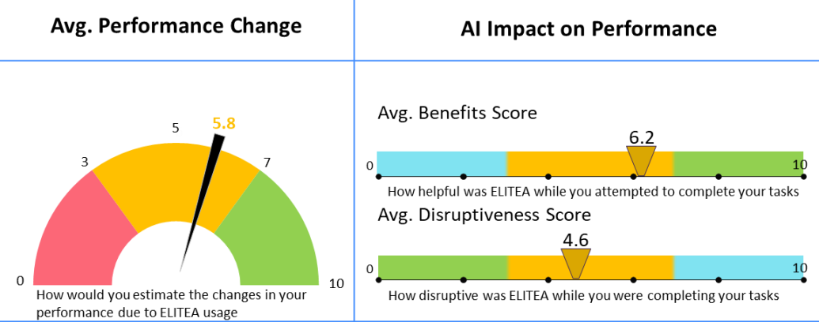
The CTC Gen AI Adoption – Current State
Gen AI for SOFTWARE DEVELOPMENT
Beyond January 2025
As of January 2025, CTC completed the initial rollout of AI Agents and Tools within their Product Engineering organization.
2024 AI Adoption Numbers:
CTC is continuing their AI Adoption, moving beyond their Product Engineering Team to other areas, with the intention to rollout across entire organization. The goal is to improve and optimize software development lifecycle based on most impactful use cases where automation and adoption of AI is meaningful.
Planned efforts for 2025:
Build additional Prompts and Agents (QA, Developer, BA)
Hand ownership of AI Adoption back to CTC including management of EliteA™, Agents, Training, and Knowledge Portal.
17 EPAM Experts
1 CTC Manager
25 Key CTC Stakeholders
8 EliteA™ Champions (Chapter Managers)
100+ Teams
6 Portfolios
100+ dedicated projects
700+ configured entities
50+ pages of EliteA™ guidance created in CTC’s Knowledge Portal

Slide 57
AI Adoption in EBSCO
From initial failure to organization-wide AI adoption with measurable impact

Slide 58
The EBSCO Gen AI Adoption – The Ask
Gen AI for SOFTWARE DEVELOPMENT
The experiment was not effective or scalable due to:
“EBSCO was looking to validate and measure the positive impact of Generative AI on software development performance and build foundational capabilities to scale across the Enterprise.”
In September 2023, EBSCO initially reached out to gain EPAM’s assistance with AI Adoption. EBSCO wanted to get started immediately with a small experiment.
The experiment included:
GitHub CoPilot with 2 Teams (not structured)
1 consultant from EPAM to run AI Adoption
No AI Champions from EBSCO
No AI Use Cases were selected and prioritized which limited ability to tailor training for the team
No Metrics defined
Unstructured adoption process
Lack of framework for integrating AI tools into existing workflows led to lack of visibility, decreased adoption rates and missed opportunities
Limited engagement in ai adoption
Low participation rates in AI-related activities and training sessions hindered momentum and adoption
Undefined baseline
No standardized, measurable metrics in place to effectively track and report productivity improvements
Lack of AI knowledge sharing
Lack of mechanism for disseminating knowledge about use cases and practices that substantially boost productivity

Slide 59
The EBSCO Gen AI Adoption – The Reset
Gen AI for SOFTWARE DEVELOPMENT
Enablement Phases
PoC Phase – Nov 2023
Initial scope of 10 Teams
Established Performance Measurement Metrics
Identified 6 AI Champions to enable EBSCO adoptions of GenAI
Wave 1 Rollout – April 2024
Scaled to 21 Teams
Established AI Adoption knowledge management space
Onboarded AI Champions
Wave 2 Rollout – July 2024
Scaled to 39 Teams
Transferred AI Office Hours/Workshops to EBSCO
Identified 4 more AI Champions
Automated Metrics Calculation
Established AI Adoption Dashboard
Established Recognition Board
Wave 3 Rollout – October 2024
Scaled to another 20 Teams
Transferred AI Adoption Dashboard to EBSCO
Transferred AI Adoption Program & Metrics to EBSCO
Established AI Champions governance
In November 2023, EPAM and EBSCO started the Gen AI Adoption Program to validate and measure the potential impact of GenAI technology on software development performance.
Program scope included:
Key Use Cases to focus on
Gathering Baseline metrics and defining what success looks like
Comprehensive AI Adoption plan implemented
Development of an AI Center of Excellence
More robust Change Plan which included Roadmap and Learning Journey
Notes:
No way to measure success
Just used the tool without any use cases defined

Slide 60
The EBSCO Gen AI Adoption – The PoC
Gen AI for SOFTWARE DEVELOPMENT
PoC Key Results
PoC Details
Drafted AI Center of Excellence structure
Identified 8 AI Champions from EBSCO
Added EPAM Roles: AI Coach, SMEs for Development and Testing
Trained all members of PoC on AI
Use Cases and Prompt Library
Trained EBSCO AI SMEs on AI Learning Journey
Identified PoC Use Cases
9-14% Velocity Boost
30% decrease in code review lead time
10% boost of code acceptance rate
ROI: ~130K net
ROI simulator projected that expanding across the enterprise would result in an ROI of approximately $1M.
Unit Testing
New Code
Refactoring Explanations
Data Preparation
Documentation
Checklist
Notes:
No way to measure success
Just used the tool without any use cases defined

Slide 61
The EBSCO Gen AI Adoption – The Rollout
Gen AI for SOFTWARE DEVELOPMENT
AI Enablement Outcomes
Over the next 9 months EPAM GenAI Consulting Team helped EBSCO build foundational GenAI capabilities, set up an impact measurement framework, and drive transformation across the enterprise.
Rollout Included:
Scaled AI Adoption from 10 to 90+ teams including 17 ARTs, 500+ engineers.
Built an AI Adoption Dashboards with automated metrics and real-time AI impact measurement.
Enhanced the Change Plan with hands-on coaching and shadow sessions for AI Champions, accelerating readiness and in-house expertise.
Established Center of Excellence for AI Champions, Contributors, and broader community participants
Launched an AI Space as a Knowledge base, AI Learning Hub, Use Case Library, Video Trainings and AI Podcasts.
Introduced a Recognition Program, celebrating achievements and sustaining engagement.
Established Governance & Transferred Key Assets and Knowledge to EBSCO, ensuring long-term success.
Velocity increase 10%
Actual ROI $1.1M
Team Budget Reduced 5%
AI Contribution to Codebase 7-9%
Team Members Trained 500+
Thank you for this great work. The challenge was significant, and it is impressive to see how well the challenge was met. And on a personal note, It's impressive to see how knowledgeable and experienced there are.
EBSCO, SVP of Engineering
Notes:
Here is how we addressed these challenges:
We acknowledge and accept the challenges faced during the initial stages of the project. We were very clear and transparent in this with stakeholder. Also, we have taken specific actions to address them effectively:
Step 1: We introduced a structured approach to define and measure AI impact, focusing on key performance metrics tailored to the ROI Calculation. The ROI is for our stakeholder so he can use and protect us in communication with company management
Step 2: Conducted workshops and regular AI/Office Hours to align on relevant use cases, ensuring they were practical and impactful for the team. At least for initial jump start teams.
Step 3: Established a governance structure, including a champion model to drive adoption and promote knowledge sharing within the organization. For this purpose, we identified about 6 AI Champions and start intensively to collect relevant use cases from them and share with the rest audience (reference to Step 2)
Step 4: Created data collection (survey) and performance measurement systems (Rally, GitHub, CoPilot etc.) so we can review all performance improvement regularly in real time. Proposed them correlation structure, so they can see how the performance improvement from day-to-day, week-to-week impacts on productivity and how that can converted to cost savings. Also, build for them Budget Planning so they can make projections for rollout
Step 5: Established OneStop Shop space in their Knowledge Base, so we can accumulate all relevant materials, use cases, prompts, etc.. in one word everything in one place, and of course promoted that
Step 6: Immediately started to train AI Champions who will serve later as foundation layer for successful rollout.
This is briefly, of course there are more nuances, like building BI tools, tailor training materials, shadow and reverse shadow sessions with champions and then contributors, recognition program, leaderboard etc.

Slide 62













Next Steps
Generative AI for software development performance
Crawl
Walk
run
Up to 10 Teams
XX Additional Teams
Organization wide adoption
TEAMS
Metrics
AI Copilots
AI Agents
AI Workflows
AI Copilots
AI Agents
AI Copilots
AI Agents
Use
Cases
Up to 5 use cases
Up to 10 Use Cases
All available Use Cases
OCM
Onboarding AI Champions and Ongoing Hands-on Support by Gen AI Consultants
Tracking of engineering metrics using interactive dashboards
Performance measurement framework and productivity gains
Use Cases & Prompts Accumulation
Curated set of learning materials
Generative AI Workshops
ROI Analysis
Notes:
Creating reusable prompts to Generative AI adoption across individuals and teams.

Slide 63
How to Sell AI/Run
Strategies to identify opportunities and pitch effectively
04

Slide 64
How to Sell
WHOM TO TARGET
WHEN TO ASK
For more information, please reach out to
WFB AI SDLC DL
Chief Technology Officer
Chief Digital Officer
Chief Information Officer
VP/Dir – Product & Tech
QBRs & Project Retros
Townhalls
Budget planning
Client Reorgs & New Exec Hires
WHAT TO ASK ABOUT
How are you working to standardize and improve your software development process? Do consistency and scalability align with your goals?
Do you have the right tools and systems to scale engineering best practices? What are the challenges you are facing with adopting new methods or tools?
How do you measure your organization performance and success in your engineering and development processes ? What metrics do you use to track outcomes?
Have you considered using AI to optimize your SDLC process? Is your team ready to explore AI-driven solutions?
WHAT TO LISTEN FOR
Clients understand their needs to optimize cost and time generally or on different SDLC phases
Clients tried experimenting with AI agents but didn’t see measurable benefits and didn`t have any system of metrics to measure progress
Clients demonstrate indications of readiness, or interest in exploring AI solutions to drive innovation, streamline processes etc., but you feel their hesitations
Clients don’t know how to leverage AI and feel frustration with inconsistent processes, lack of standardization, or difficulties in adopting new AI tools and methodologies
Notes:
Adam 1. does client want to grow and improve, 2. do client has approach and instruments to adopt improvements, 3. does client have measurements for it, 4. and does client ready to move with AI.

Slide 65



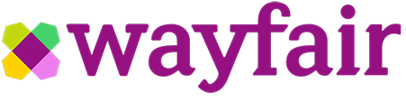
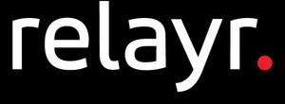


EPAM AI/Run One-Pager
WHY
TYPICAL USE CASES
What You Can Hear from the Business
Leverage AI assistants for roles like BA, Developer, QA, and PM, enhancing productivity and efficiency across your projects
Efficiently manage data from diverse sources like Jira, Confluence, and various file formats, ensuring streamlined access and organization
Enable seamless collaboration among multiple AI assistants, improving coordination on complex tasks
KNOWLEDGE AND REQUIREMENTS MANAGEMENT
Knowledge Management & Onboarding
Business Requirements Elaboration and Documentation
Code Analysis and Exploration
DEVELOPMENT
Accelerated Bug Fixing​
Unit Test Coverage Increase​
AI Driven Code Quality Pipelines​
QUALITY MANAGEMENT​
AI-augmented Software Testing​
Testing Automation​
WHAT
Key Capabilities
PROJECT MANAGEMENT​
Release Management
Estimations
Risks Assessment
MODERNIZATION
Code Conversions
Frameworks versions upgrade
Solution Re-architecture
Mainframe Modernization
SUPPORT
Comprehensive SDLC Smart Assistance and Assistants Library: Offers pre-built AI assistants for roles like BA, Developer, QA, and PM to enhance productivity and automate routine tasks across the SDLC.
Assistants Constructor: It allows you to create personalized AI assistants tailored to your project's specific needs.
Indexing and Data Management: Supports data indexing and management for sources such as Jira, Confluence, various file formats (PDF, PPT, Excel, etc.), and Git.
Support for Multi-Agent Workflows: Enables multiple AI assistants to collaborate on complex tasks, enhancing coordination and efficiency.
Extensive Library of Tools: Includes tools for VCS, codebase management, research, cloud integration, Jira, Confluence, open APIs, notifications, and data management.
L1
Support Optimization​
L2/L3
AI Assisted
Our Clients:

Slide 66
Practical Use Cases of AI for Software Development
AI for Engineering

Slide 67
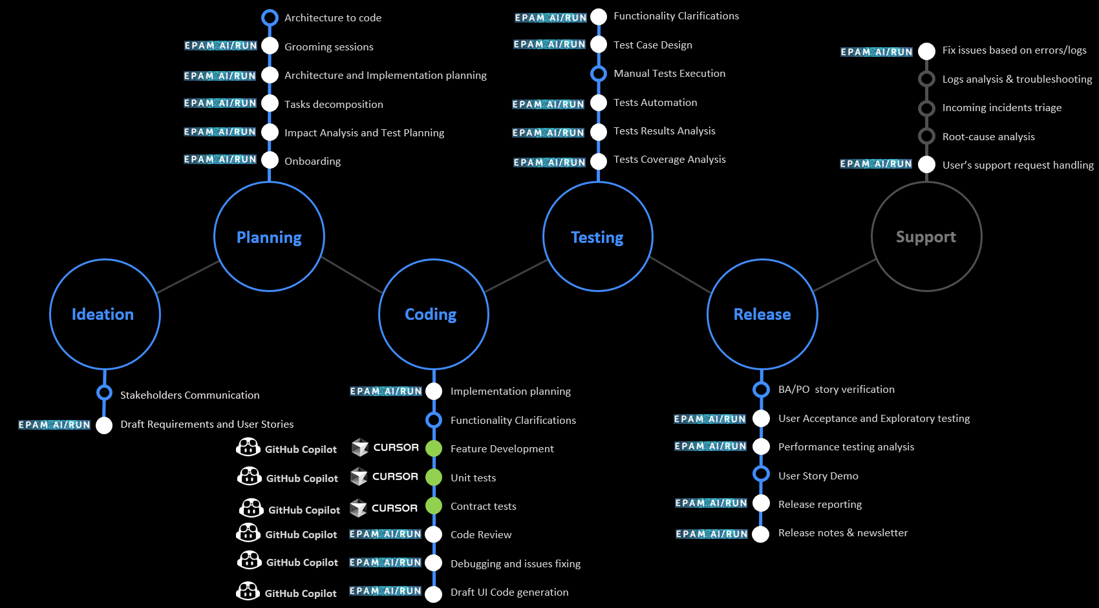
How SDLC Stages Can be Optimized with Selected AI Tools + EPAM AI/Run
Practical Use Cases of AI for Software Development
Notes:
Last Update date: ? Slide Owners: Thought Leaders: Aliaksandr Paklonski /Tatsiana Hmyrak
Senior Practitioner: Tatsiana Hmyrak

Slide 68
Practical Engineering Productivity Use Cases
Practical Use Cases of AI for Software Development
Custom per Use Case
Out-of-the Box Copilots/Agents
Autonomous AI Workflows
Task-Driven Interactive AI Agents
USE CASES
No-Code:
Code migration to newer third-party library versions
Test generation (unit, integration)
Standard component generation
Implementation of simple to medium-known algorithms
Sample data generation
Learning or transitioning to less familiar technologies or codebases
High-Code:
Guided code migration involving significant paradigm shifts (e.g., AngularJS to Angular/React.js)
Test generation in environments with client-specific logic and frameworks that out-of-the-box AI Tools cannot recognize
Code exploration
Guidance and suggestions for where to make changes
Business requirements generation
Low/No-Code:
Onboarding through interaction with the code
Troubleshooting and bug investigation
Code review and PR assistance
High-Code:
Batch framework version upgrades for full codebases (e.g., Java, .NET, Angular)
Creation of automated pipelines to cover code with missing tests (unit, integration, end-to-end), increasing coverage to the desired percentage
Code analysis and discovery, including issue troubleshooting reports and documentation creation
Creation of pipelines to automatically fix minor bugs (e.g., spelling, UI issues)
Code or solution migration
Low/No-Code:
Creation of pipelines to automatically address typical issues found by scanners like Sonar and Checkmarx
TOOLS
High-Code
High-Code
GitHub Copilot
Amazon Q Developer
Gemini Code Assist
Cursor (including Composer)
Windsurf
EPAM AI/Run
GitHub Copilot Extensions
Microsoft Copilot Studio Agents
EPAM AI/Run
Mostly custom solutions
Low/No-code
Low/No-Code
Quality
Quality
Value
Quality
Cost
Value
Cost
Value
Cost
Notes:
Last Update date: ? Slide Owners: Thought Leaders: Aliaksandr Paklonski /Tatsiana Hmyrak
Senior Practitioner: Tatsiana Hmyrak Automation Code Review Integrates with CI pipelines to review and validate code changes automatically.Test Data Generation Dynamically creates or masks test data for various scenarios, including edge cases.Automated Maintenance Updates and maintains scripts as application changes occur (healing locators, etc.).Autonomous Triage & Root Cause Analysis Uses AI to group similar defects and pinpoint underlying issues faster.Compliance & Standards Review Flags potential regulatory or standards-related gaps (e.g., security, accessibility).AI-Driven Extensions Integrates AI-based features into existing QA platforms (e.g., predictive analytics, self-healing tests).

Slide 69
Code Assistants Leaderboard
Practical Use Cases of AI for Software Development
Category | Executive Summary on Code Assistant Research | Final Score | Low Complexity Only (144 tests) | Medium Complexity Only (25 tests)
GitHub Copilot + GPT-4o | Appeared to be the best in code-completions and very good at chat tests (but not the best). As of Spring 25 has agentic feature in very heavy development/experimental state. Also lacking some enterprise features like standalone deployment. Improved plugins for JetBrains tools and full Visual Studio - they almost caught on VS Code | 88% | 89% | 80%
Cursor + Claude 3.7 Sonnet | A landmark of how standalone GenAI-enabled IDE may look like in the future. VS Code-based only - which may pose significant limitations for enterprise developers (Java, .NET, front-end) - in such cases may represent an interface to AI features including the agent. Has the most capable agentic feature, although this feature isn't ideal - can solve small to medium tasks with moderate complexity. | 87% | 88% | 80%
Cursor + Gemini-2.5-pro-exp-03-25 | A landmark of how standalone GenAI-enabled IDE may look like in the future. VS Code-based only - which may pose significant limitations for enterprise developers (Java, .NET, front-end) - in such cases may represent an interface to AI features including the agent. Has the most capable agentic feature, although this feature isn't ideal - can solve small to medium tasks with moderate complexity. | 87% | 87% | 88%
Cursor + GPT-4o | A landmark of how standalone GenAI-enabled IDE may look like in the future. VS Code-based only - which may pose significant limitations for enterprise developers (Java, .NET, front-end) - in such cases may represent an interface to AI features including the agent. Has the most capable agentic feature, although this feature isn't ideal - can solve small to medium tasks with moderate complexity. | 82% | 83% | 76%
Cody (Sourcegraph) + Claude 3.7 Sonnet | Quality is good - a bit worse then leaders but almost on par with Cursor + GPT-4o. Provides very wide spectrum of enterprise features like standalone deployment, very wide support of IDE plugins, prompt library, code insights, code search etc. Agentic interface is in heavy development but already is of moderate usefulness/quality | 80% | 81% | 80%
Source: github.com
Notes:
Last Update date: April 9 Slide Owners: Thought Leaders: Aliaksandr Paklonski /Tatsiana Hmyrak
Senior Practitioner: Tatsiana Hmyrak

Slide 70

Thank you
AI/Run Team
WFBAISDLC@epam.com
Please reach out to us
WFBAISDLCPresales@epam.com

